Slide 1
Hack A Solar Circuit
Group Name:
Student’s Name:
Resource by Srividhya Sundaram

Slide 2
Exploration: Hack A Solar Circuit
Ensure that anyone and everyone in your group is wearing safety glasses and work gloves to protect your eyes and hands during the activity from plastic fragments
Get an adult to help break apart one or more of the outer coverings of a solar-powered device
With the help of an adult, use tools like a screwdriver to remove all inner circuit components, being careful not to break individual components as you work. Avoid puncturing any of the electrical components; some may need force to be applied before they can be removed.
Carefully examine the inside of the device and all of the individual circuit components. Here’s what you might find: a solar panel, LED bulb, transistor, battery holder with a battery, transistor and a chip. Use [the checklist in your engineering notebook] to guide as you discover each of the components in the circuit.

Slide 3
Materials
Materials required
Solar garden light or toy
Options:
Mini spotlights
Stake Lights
Pathway Lights
Solar-powered dancing toy
Precision screwdriver set, hammer, flathead screwdriver
Safety glasses and leather work gloves (for all observers)

Slide 4
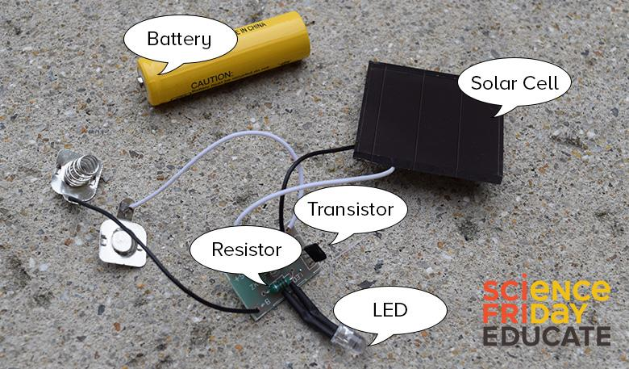
Garden Light Dissected
Use this image to help you make sure you didn’t miss any parts of your circuit

Slide 5
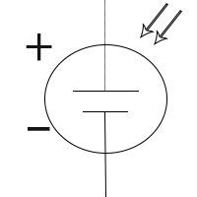
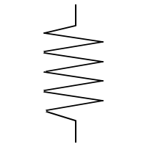
Find The Components
Name of the component | Schematic Symbol | Checkmark this box as you find the component | What does this component do?
Solar cell
Resistor

Slide 6
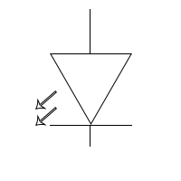
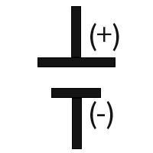
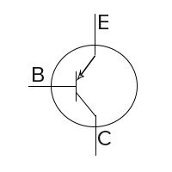
Find The Components
Name of the component | Schematic Symbol | Checkmark this box as you find the component | What does this component do? | Picture of component
LED
Battery
Transistor

Slide 7
Reflect Upon Your Destruction
On your solar circuit diagram, use arrows to illustrate to show the flow of electrons. | Write a brief explanation of how electricity is generated and flows through the circuit.

Slide 8
Solar Cell

Slide 9
Circuits

Slide 10
Plan And Build Your Own Circuit
Using the solar circuit as inspiration, you will design, sketch and build your own simplified solar-powered circuit. For this build, you need to focus on only two parts: the solar panel and the LED bulb. If you are able to take the solar panel and the LED bulb from the garden light without damaging them (strictly under adult supervision only), you can use those supplies instead of buying them. However, for reliability, you may want to use new components.

Slide 11
Your Circuit Design
Sketch your planned solar circuit in your engineering notebook, in the same style and using the same symbols you used to sketch the solar circuit in the first activity.
Be sure to describe the role of each component and how it will work within your circuit.

Slide 12
Describe the process
Explain in the section below how you and your group ultimately created your design. Be sure to provide specific details such as the order you did things, what pieces were connected where, and anything you made sure you did or didn’t do to achieve your desired end result.

Slide 13
Your Finished Circuit
Place an image or sketch of your finished design here

Slide 14
Origami

Slide 15
Create Your Own Origami Circuit
Design Constraints
Your challenge is to integrate your solar circuit into an origami structure to create a lightweight, foldable, solar-powered device that solves a problem.
Design and Build your solar-powered origami:
Identify a problem that your origami, solar-powered device will solve
Make an origami pacman, hat, fan, crane, or other origami structure (an animatable)
Integrate and adapt your solar power circuit into your a technology using origami and your solar light circuit.
Materials
Solar-powered circuit
Square sheets of paper
Scissors
Your design must address a real problem
You may only use the materials provided to you by your teacher to construct your design
Must work consistently after being folded and unfolded multiple times
Your design cannot harm humans or innocent animals
What Problem Will Your Design Solve?

Slide 16
Your Circuit Design
Sketch Your Design
How Will It Work?

Slide 17
Describe the process
Explain in the section below how you and your group ultimately created your design. Be sure to provide specific details such as the order you did things, what pieces were connected where, and anything you made sure you did or didn’t do to achieve your desired end result.

Slide 18
Your Finished Origami Circuit
Place an image or sketch of your finished design here

Slide 19
Troubleshooting
If you’re experiencing problems:
Make sure to connect the positive terminal of the solar panel to the positive terminal of the LED and negative terminal of the solar panel to the negative terminal of the LED.
If your contraption does not work, here are some possible solutions.
If your LED bulb does not glow, even after making the connections as described in the previous step test it with a coin cell battery. If it does not work, you might want to try it out with another LED bulb.
If the LED bulb works well with the coin cell battery but does not work with solar panel, check if you have enough sunlight for the solar panel to be efficient.
If opening and closing the origami structure does not stimulate the ‘on’ and ‘off’ of the circuit, make sure if you have placed the electrical components in locations that closes and opens the circuit correctly.
If you are using a good working motor and it does not start with a solar panel, it might need a gentle push from you to get started.

Slide 20
Reflection Questions
Directions: Answer the following questions using evidence from your experience. Ideal answers should use specific evidence from the activity to justify answers.
Were you able to create a circuit with your origami creation? What evidence do you have that you created a circuit?
How does your solar panel work? Explain it in your own words.

Slide 21
Reflection Questions
Draw the origami circuit you have created. Label the following components in your diagram - load, power source and conducting material. Explain how your circuit works.

Slide 22
Reflection Questions
What are some of the benefits of using origami in STEM (science, technology, engineering, and math) fields and careers?
What are the some of the challenges you encountered during this process? How did you overcome your challenges?

Slide 23
Reflection Questions
What ideas of your own did you apply to your creation? Why did you do so?
Did you try other origami structures? Which one did you choose?

Slide 24
Reflection Questions
After watching the applications of origami in different fields, which one impressed you? Why?
To what other fields do you think origami could be applied? How do you think it would help to design better solutions?

Slide 25
Origami Circuit Rubric For Reflection Questions
 | 3 | 2 | 1
Origami Circuit’s Electronic Functionality | Design was created and operated as a fully functional circuit by lighting up LED, sounding the buzzer, etc. The creation functioned normally and did not have to be specifically held at a certain angle for example for the circuit to work. The circuit worked consistently despite repeated manipulation of the origami circuit. | Design was created and operated as a fully functional circuit by lighting up the LED., sounding the buzzer, etc. The origami creation needed to be manipulated, held, or maintained in a specific angle in order for the circuit to be completed. | Design was created, but the LED or other device did not work or did not work in a consistent manner as the origami was manipulated.
Origami Circuit’s Origami Functionality | The origami creation was able to fold and unfold and fold repeatedly without negatively impacting the circuit. | The origami creation was able to fold and unfold a limited number of times or only with specific assistance from the designers. | The origami creation was unable to fold and unfold without tearing.
Origami Circuit’s Problem Solving Ability | The origami folds created a design capable of addressing the desired problem.The designed created to do so solves the problem in a manner, which is both realistic and unique. | The origami folds created a design capable of addressing the desired problem. | The origami design does not reasonably address the group’s desired problem.
Reflection Questions | Reflection questions were answered and specific evidence from the activity was used to justify answers. | Questions were answered, but evidence used did not connect to the activity. | Questions were answered incompletely with little or no relevant evidence.

