Slide 1
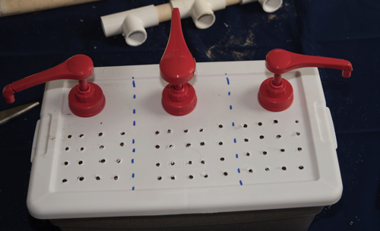
Instructions For Building
A Three-Pump
Shared Aquifer Model

Slide 2
Overview
The following groundwater model and simulator can be constructed for less than $5.00 with a little planning. The most difficult parts to attain are the large pumps, but if you ask your students to donate pumps from home, a surprising amount will show up at your desk in just a few short weeks. The pumps shown in this particular model are condiment pumps found at an outlet store for $0.50 a piece. Larger pumps are preferred since fine grit will not readily gum-up their mechanism. Smaller hand soap pumps will work, but tend to wear out after one year of usage. They may be useful for simulating smaller residential wells if you choose to create new scenarios to simulate in the model.
Materials Needed:
Three pumps
3’ of PVC ½” pipe.
Three ¾” PVC “T” couplers.
8” x 8” ground cloth
Three Zip Ties
Plastic shoe box

Slide 3
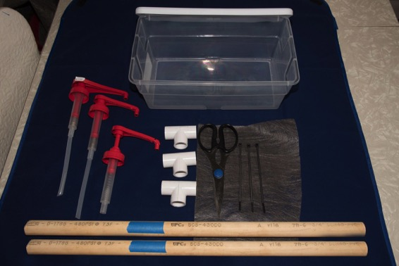
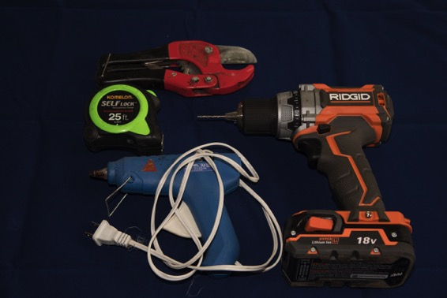
Materials Needed
Tools Needed
Three pumps
3’ of PVC ½” pipe.
Three ¾” PVC “T” couplers.
8” x 8” ground cloth
Three Zip Ties
Plastic shoe box
PVC Cutters or Hacksaw blade.
Tape measure or ruler.
Drill
Optional hot glue gun
1/16” Drill bit
3/16” (or so) Drill bit

Slide 4
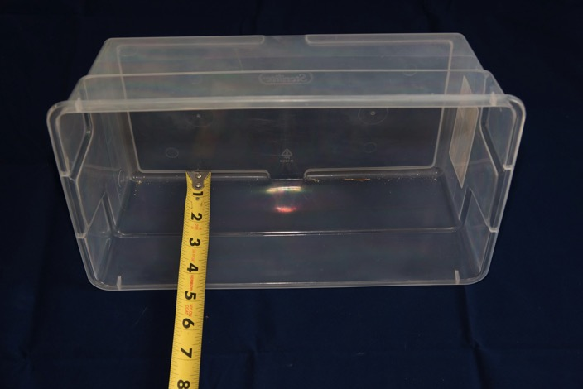
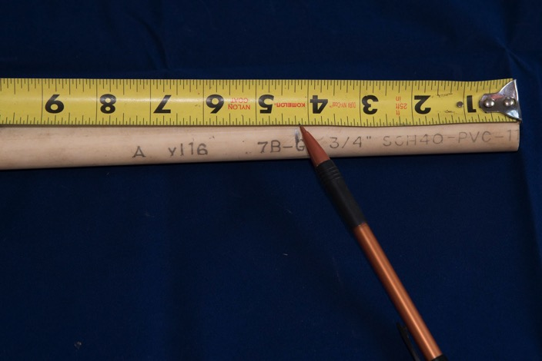
Step #1
Step #2
Measure the depth of the plastic shoebox. This will be the height of your well casing.
Measure a length of ¾” PVC pipe that corresponds to the depth of your plastic shoe box. Mark with a pencil. (As an example, the box in the photo was 4.25” deep, so I measured 4.25” from one end of my PVC.)

Slide 5
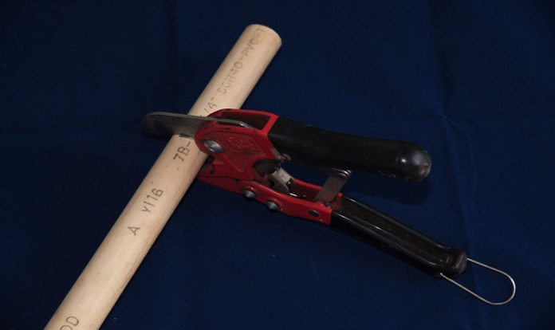
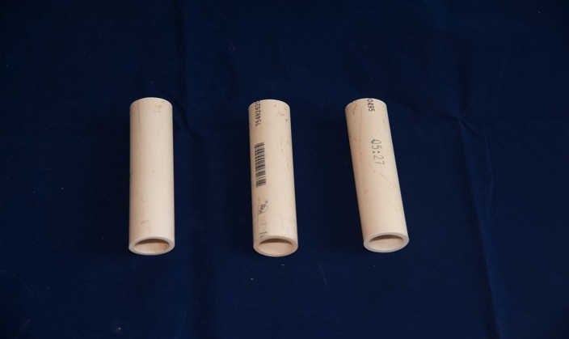
Step #3
Step #4
Cut the PVC using the cutters or hacksaw.
Repeat the previous two steps twice. You’ll now have three equal lengths of PVC for our well casings.

Slide 6
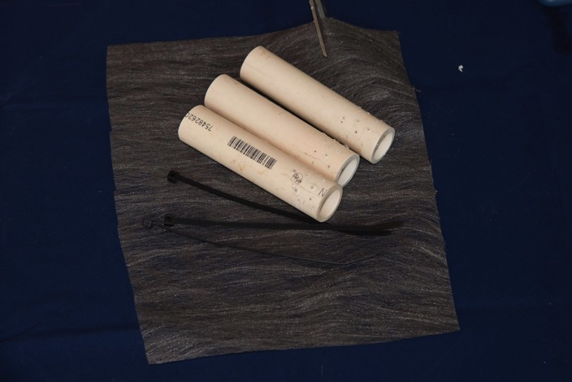
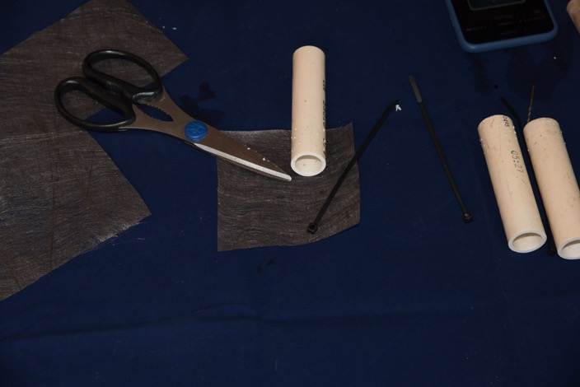
Step #5
Step #6
Cut a piece of garden cloth that is large enough to wrap around and cover the PVC well casing and their freshly drilled well screen.
The resulting ground cloth square.

Slide 7
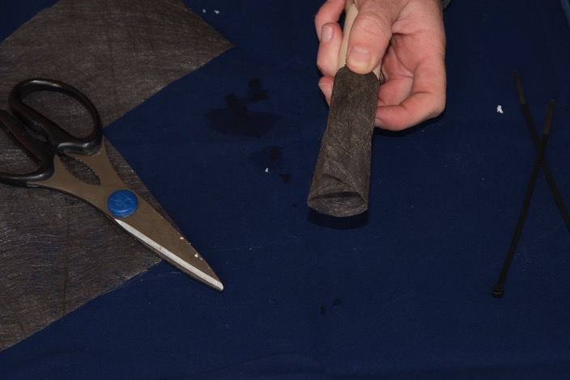
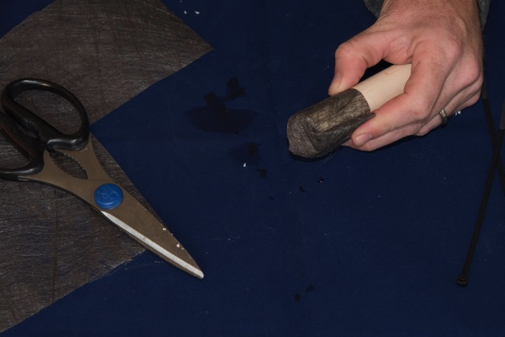
Step #7
Step #8
Wrap the cloth around the well casing and well screen (the tiny drilled holes).
Fold the excess cloth back towards the top of the casing. It will prevent large sediment from entering the bottom of the casing.

Slide 8
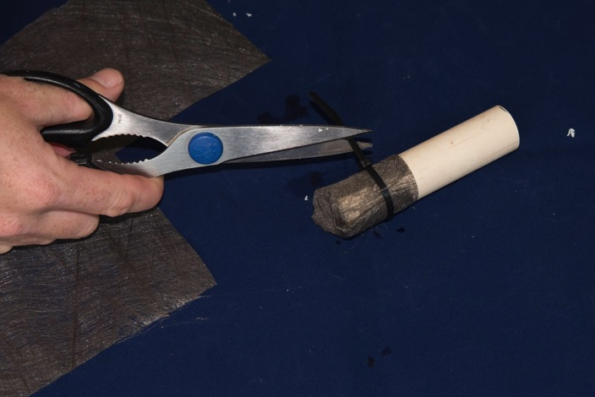
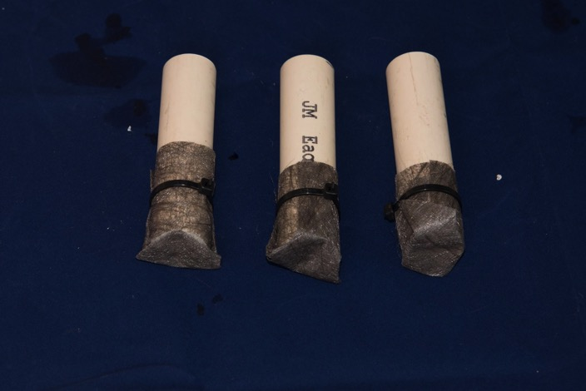
Step #9
Step #10
Zip Tie the cloth to the well casing. Trim the excess zip tie.
Completed well casings.

Slide 9
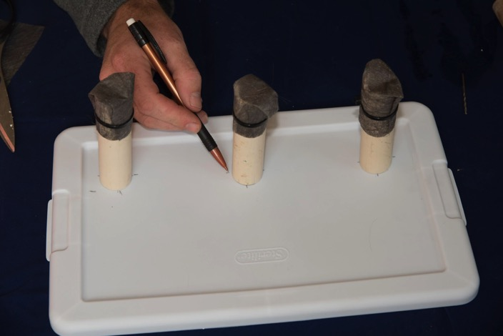
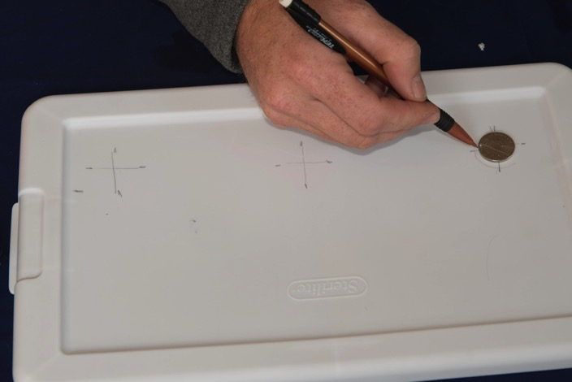
Step #11
Step #12
Making the well openings on the “surface”. Place the three well casings on the shoebox top as shown. Guesstimate an even spacing along one of the long sides of the box top. Then make four tick marks: one at the top, bottom, left and right of the well casing.
Roughly connect the tick marks to create a centering guide. Center a nickel in the cross hairs and trace around the nickel. Its diameter is nearly the same as the inside diameter of the PVC pipe.

Slide 10
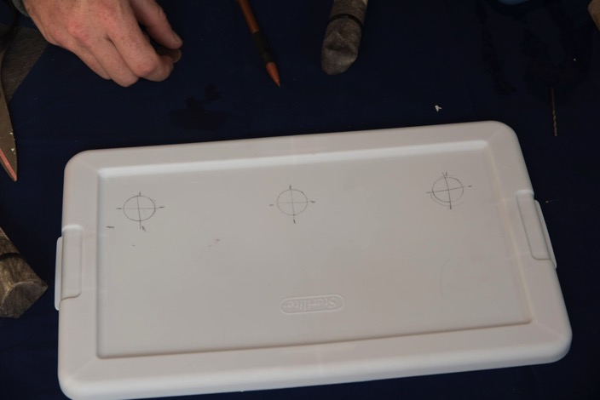
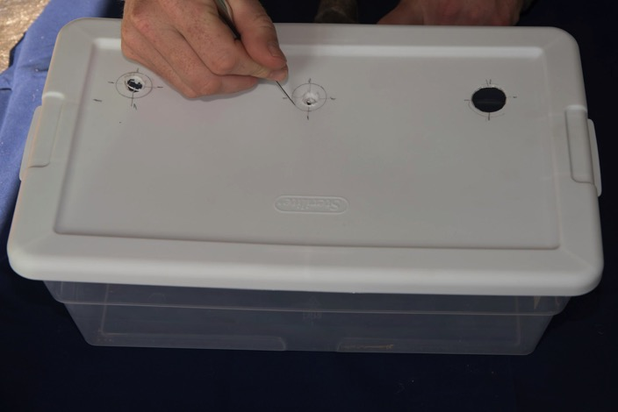
Step #13
Step #14
Box top with all three nickel tracings.
New box tops are fairly flimsy, which in this case is a good thing. It makes them easier to cut with a hobby knife. Carefully cut out the nickel tracings using the hobby knife. (A large hot-glue gun can also be used to melt holes of the desired size).

Slide 11
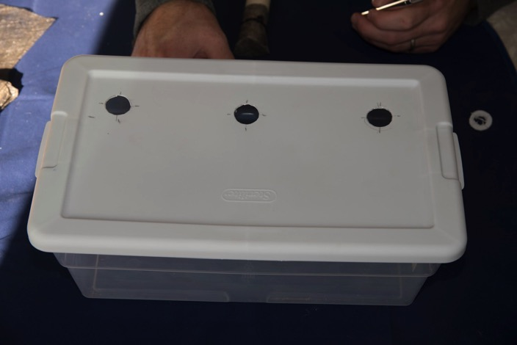
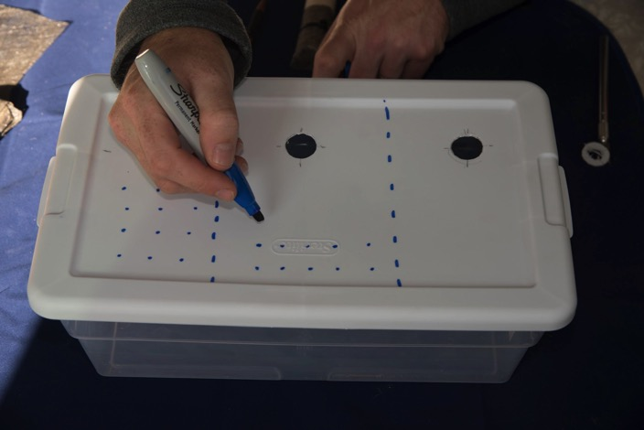
Step #15
Step #16
Finished well holes on the surface of the model.
Guesstimate or measure and divide the box top into three sections by drawing dotted lines with a permanent marker. This will become three separate plots of land.

Slide 12
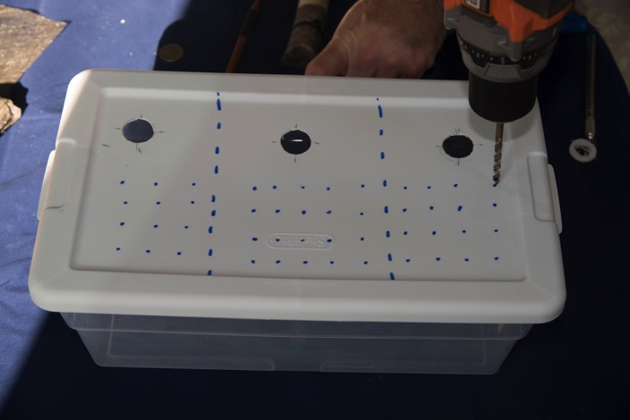
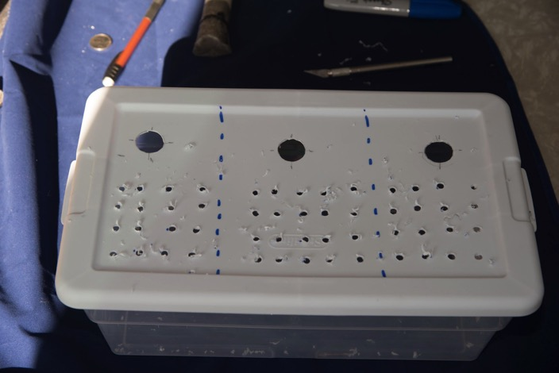
Step #17
Step #18
Roughly place anywhere from 12 to 20 blue dots on each partitioned piece of “land” on the box top. With a 3/16” drill bit, go crazy punching the holes. (If you don’t have a drill, the tip of a hot glue gun can be used to melt the holes. It’s not as an efficient process).
Shoebox top with all holes drilled. The holes will become the infiltration zones for our aquifer.

Slide 13
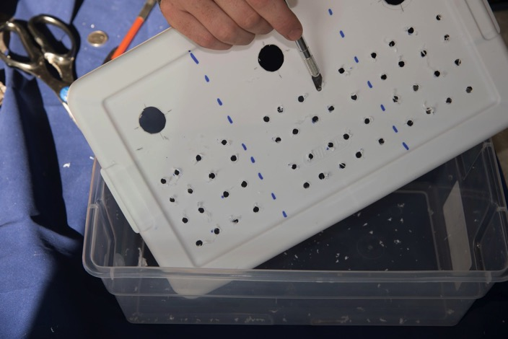
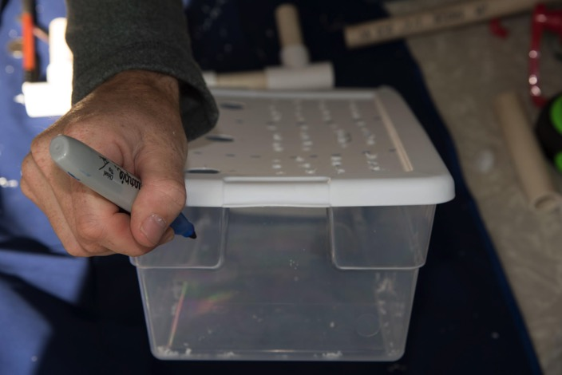
Step #19
Step #20
Clean all the burrs from around the holes.
Draw a vertical line on the side of the shoebox that aligns with the centerline of each well hole. This will be used for well casing placement and alignment in the future.

Slide 14
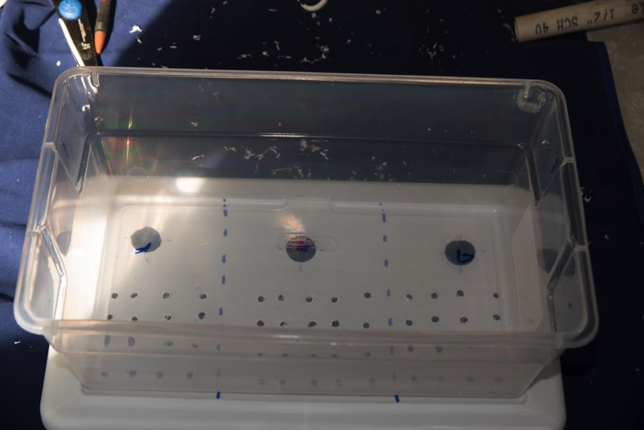
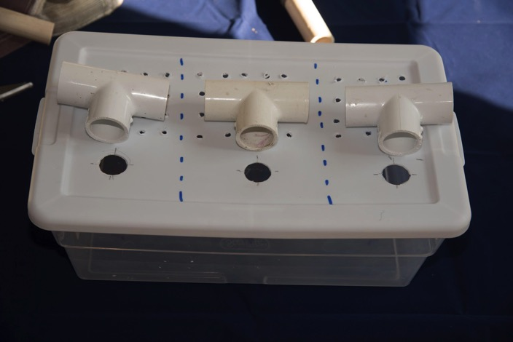
Step #21
Step #22
One can also place the shoebox on top of the box top and mark the center points of the well holes on the bottom of the shoebox. The marks will aid in well casing alignment in the future.
This tool will help quickly “reset” an aquifer between classes if using pollution simulants. Polluted sand will need to be dumped and rinsed and fresh sand added. This tool will keep the well casings aligned and in their proper placement. Start by aligning the three “PVC” T’s with the well holes on the box top.

Slide 15
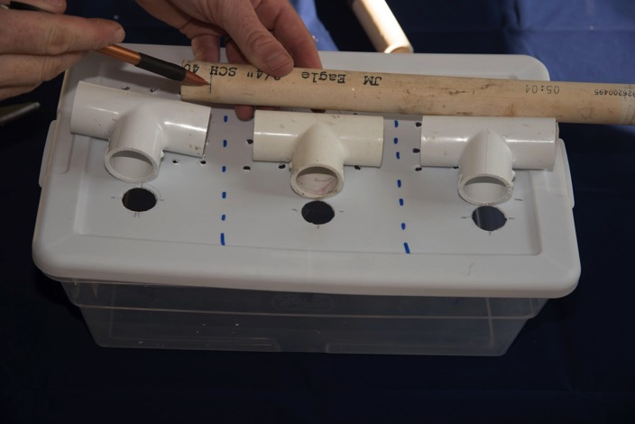
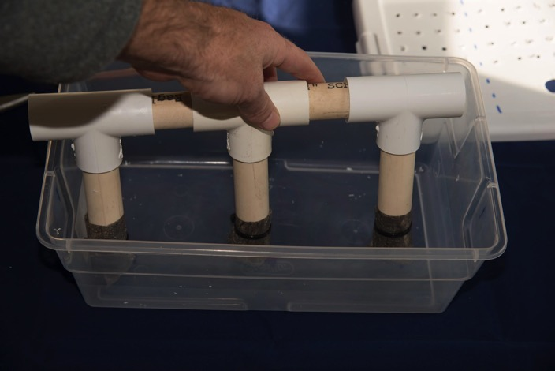
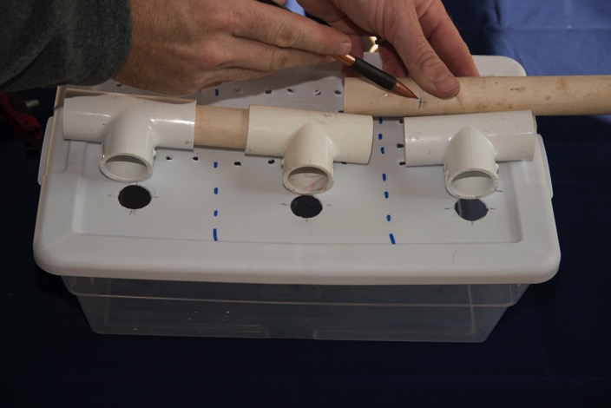
Step #23
Step #24
Cut small a small length of ¾” PVC pipe to connect the first set of T’s. Keep in mind that you want the T’s hole aligned with the well holes. Most PVC T’s accept about ½” of pipe when compressed, so take that into account when eyeballing the length.
Attach the first two T’s. Then cut another small length of PVC pipe to attach the third T.

Slide 16
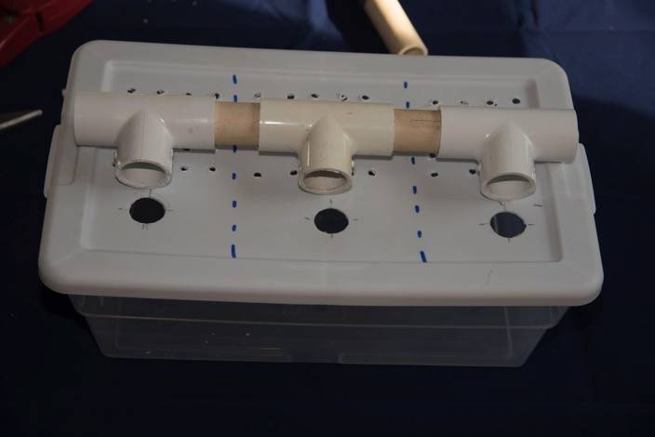
Step #25
Step #26
The final alignment guide should look like this when completed.
Attach the well casings to the alignment guide. Place them into the shoebox and align them with the markers drawn in steps 23 & 24.

Slide 17
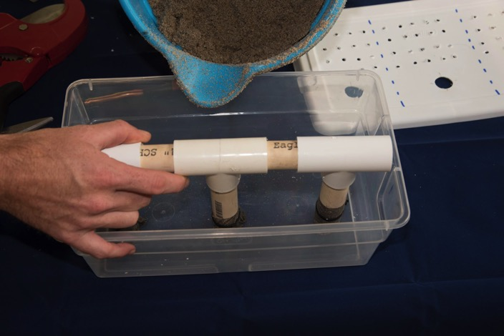
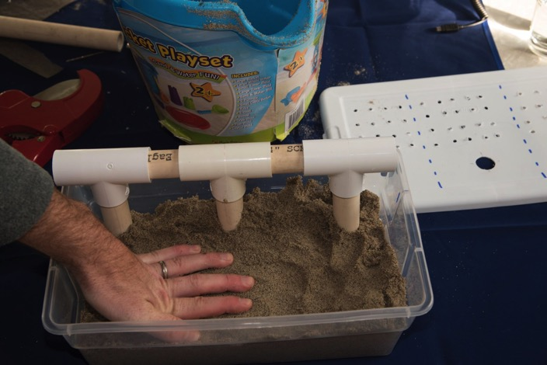
Step #27
Step #28
While holding the well casings in place using the alignment guide, pour or scoop sand into the box.
Tamp down the sand after every inch or so. If the sand is dry, just make sure it is evenly distributed.

Slide 18
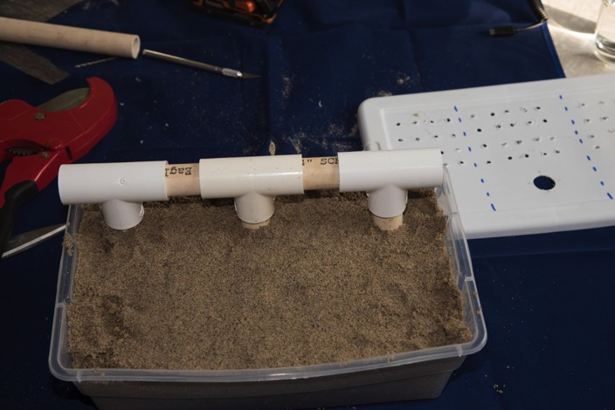
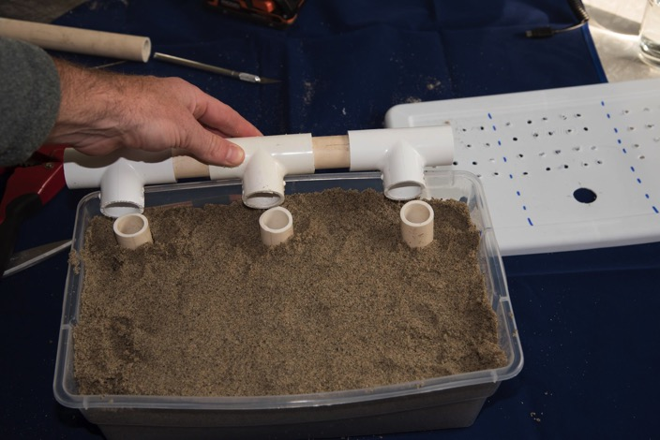
Step #29
Step #30
Fill the sand to ½” from the top of the box.
Remove the alignment guide (no sand in casings!).

Slide 19
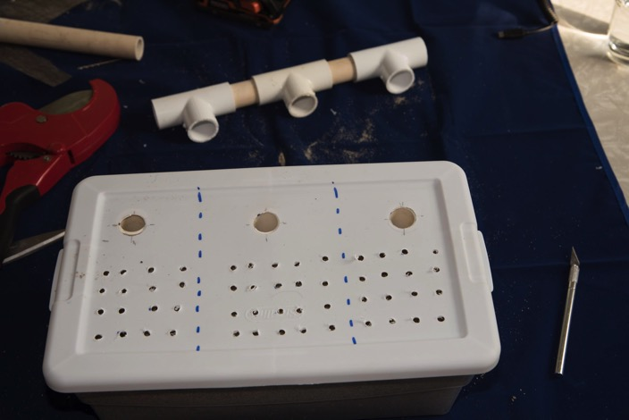
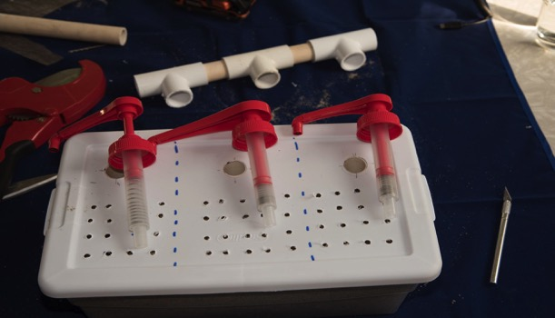
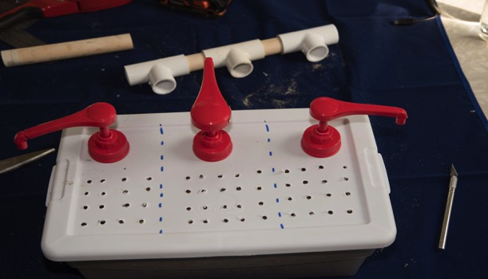
Step #31
Step #32
Place the box top onto the box. Align well holes with the casing.
Drop the casing pumps into the casings.

Slide 20
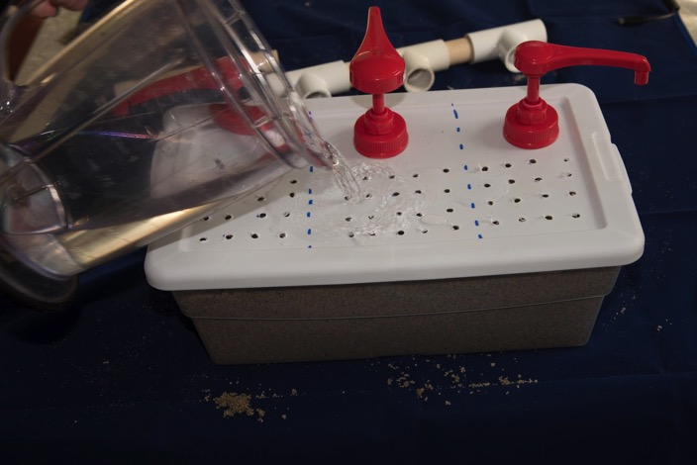
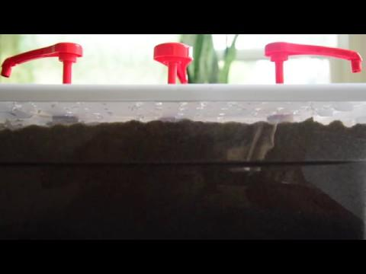
Step #33
Step #34
Slowly pour water onto the land and let it infiltrate into the aquifer. Stop when the soil is saturated and a small film of water is seen on top of the sand.
Water infiltration into aquifer.

Slide 21
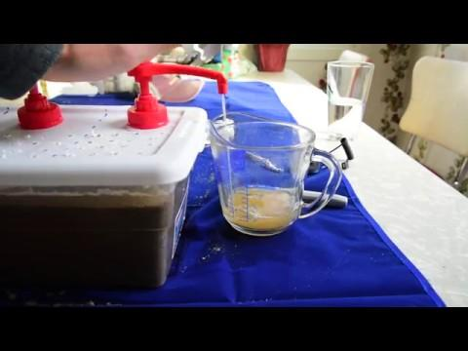
Step #35
Test the pumps to make sure the wells are functioning properly.
Note: If using soap or shampoo pumps, it is useful to attach 1’ lengths of rubber tubing to the nozzles of the pump. This way water will be more easily transported to the awaiting beakers.

