Slide 1
Paleoart
Student Name:
Resource created by Brian Soash

Slide 2
I Chose Specimen...
Copy and paste smaller versions of the images from your specimen below.
Images Courtesy of ReBecca Hunt-Foster

Slide 3
Identifying Your Fossil
What Order Does Your Dinosaur Fit In?

Slide 4
Step #1, Fossil Location: The Morrison Formation
Directions: All of our fossils will be found in the Morrison Formation. What does that mean in terms of how old your fossil is? What does this mean about the environment of your location at that point in time? Great information about the Morrison Formation can be found here at Dinosaur Monument National Park’s website and Encyclopedia Britannica’s website. You can also use the Howard Hughes Medical Institute’s Earth Viewer to help you see what the world looked back during the time your organism was alive.

Slide 5
Based On The Information About The Morrison Formation What Dinosaurs Would You Expect To Find In This Location?

Slide 6
Step #2 Characteristics Of The Fossil
Directions: Make observations about your fossil. No detail can be too big or too small. As you make observations, write down every detail you see. It could be the difference between finding another specimen or a whole new species!
Specimen Letter Label | Details
A
B
C

Slide 7
Step #2 Characteristics Of The Fossil (continued)
Specimen Letter Label | Details
D
E
F
G
H

Slide 8
I Believe The Fossil Is Or Is Related To...
Directions: Based on the information in the pictorial dinosaur guide what can you conclude about your fossil?
Claim
Evidence
1)
2) 3)

Slide 9
Reasoning
(Why does your evidence support your claim? Be specific and directly reference your evidence. Each piece of evidence should be used in your reasoning.)

Slide 10
My Dinosaur Is A...
Describe the diet of your dinosaur. Be sure to cite specific evidence from your fossils, the examples, or any other outside research you conducted. *Go beyond simply labeling it a carnivore, herbivore, etc. what type of things did it eat insect, leaves off of the tops of trees, etc.

Slide 11
My Dinosaur Is A...
Based on the characteristics of your fossil, in what type of environment do you believe it lived?
Based on geologic evidence how long ago did your dinosaur live and in what era did it exist? What were conditions like in that era?
Based on your conclusions from the previous questions, what coloration or markings do you believe your dinosaur may have had?

Slide 12
Creating Your Paleoart
What Does It Look Like?

Slide 13
Here The Methods Use From An Actual Paleoartist Gabriel Ugueto

Slide 14
Begin Bringing Your Organism Back To Life Part #1
Create an outline of the body structure of your organism here. Look at the examples from your guide, other research online, or in books that can help you create the shape and posture of your organism. Be sure to ask yourself questions such as how many legs did it walk on, did it have any large body features like horns, plates, or crests, and what position was its tail, head, or arms in when it moved.

Slide 15
Similar Creature Alive Today
What In Your Opinion Is A Creature That Is Alive Today That Is Most Similar To Your Organism | Habitat Of The Similar Organism | Insert A Picture Or Sketch Of The Similar Organism

Slide 16
Begin Bringing Your Organism Back To Life Part #1
Create an outline of the body structure of your organism here. Look at the examples from your guide, other research online, or in books that can help you create the shape and posture of your organism. Be sure to ask yourself questions such as how many legs did it walk on, did it have any large body features like horns, plates, or crests, and in what position was its tail, head, or arms in when it moved.

Slide 17
Begin Bringing Your Organism Back To Life Part #2
Using something as a backlight such as a flashlight or a window sketch your organism from Part #1 on the previous page here. Test different color patterns and options to decide what best fits your organism. Use multiple versions of this page if need be. If you’re doing this electronically, paste an image of your drawing here and try out different colorations.

Slide 18
Color And Skin Of Your Creature
Describe the skin and features of your dinosaurs. What should it look like, what features should it have, and why? EXAMPLE: Does your creature have feathers? Did your creature have scales? Did your creatures have crests or other ornamental features?
What should the skin color(s) be for your organism? Is there any type of pattern, coloration, or camouflage that your creature would have? Describe what features it should have and why, based on your research and observations.

Slide 19
Begin Bringing Your Organism Back To Life Part #3
Using the same technique from recreating your creature’s outline in Part #2, create a sketch of your organism with the color scheme you chose. Then apply the appropriate environment to complete your paleoart. Be sure to keep in mind your earlier research about what it ate, the environment it lived in, the shape of its body, and other features that might give you a clue to how it lived and where it lived.

Slide 20
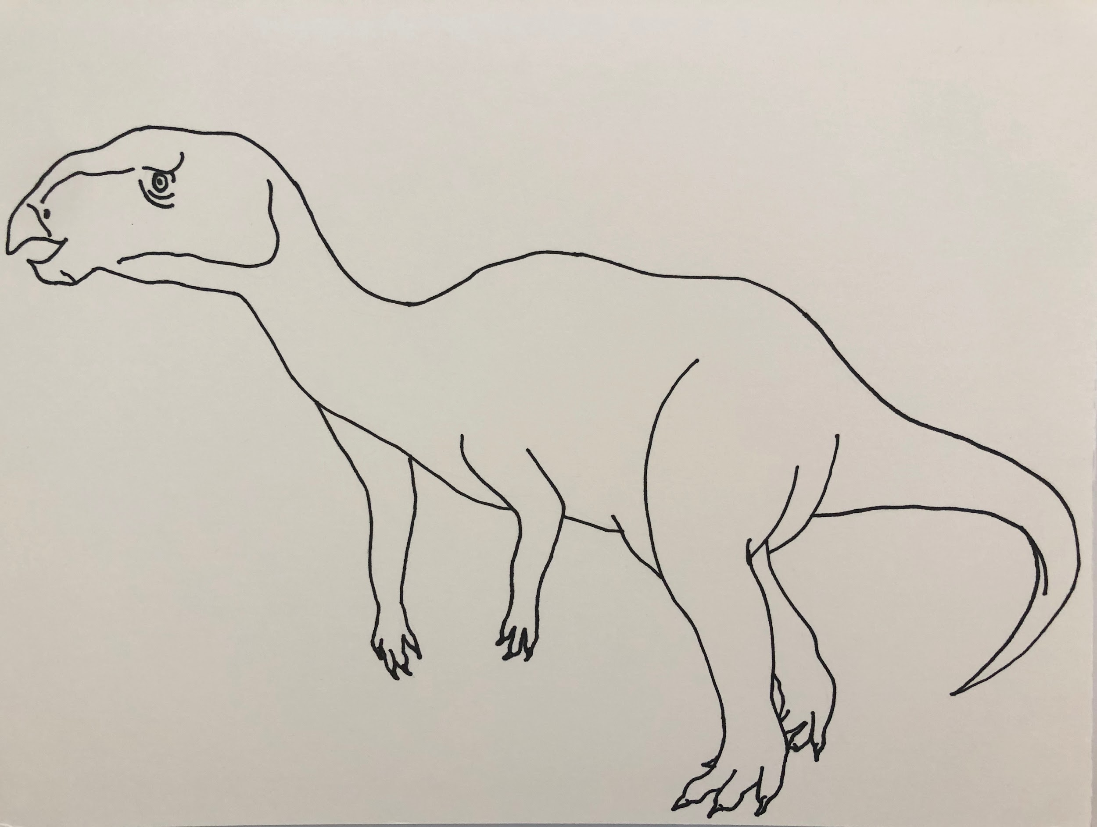
EXAMPLE Begin Bringing Your Organism Back To Life Part #1
Create an outline of the body structure of your organism here. Look at the examples from your guide, other research online, or in books that can help you create the shape and posture of your organism. Be sure to ask yourself questions such as how many legs did it walk on, did it have any large body features like horns, plates, or crests, and in what position was its tail, head, or arms in when it moved.
Images by Beverly Owens

Slide 21
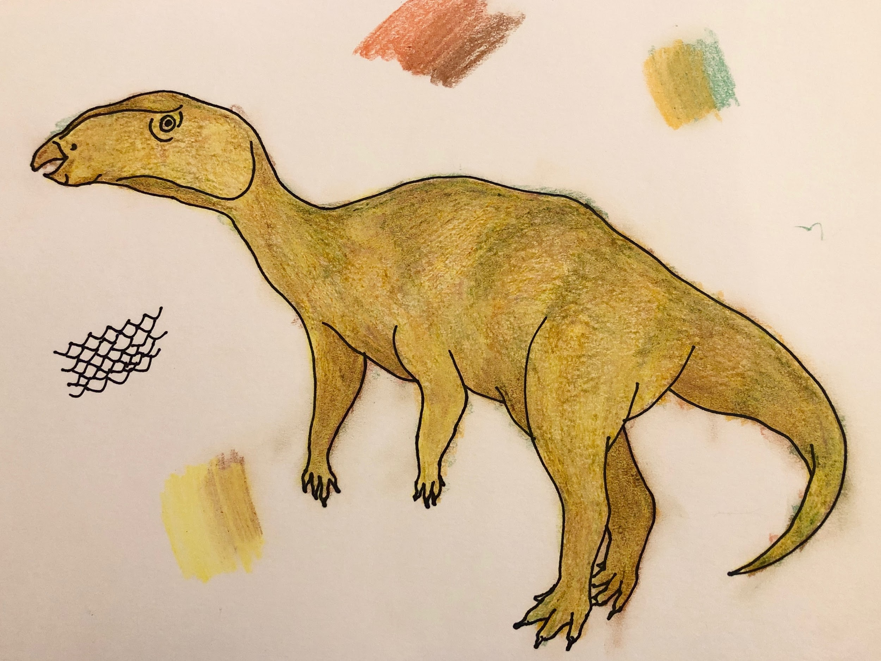
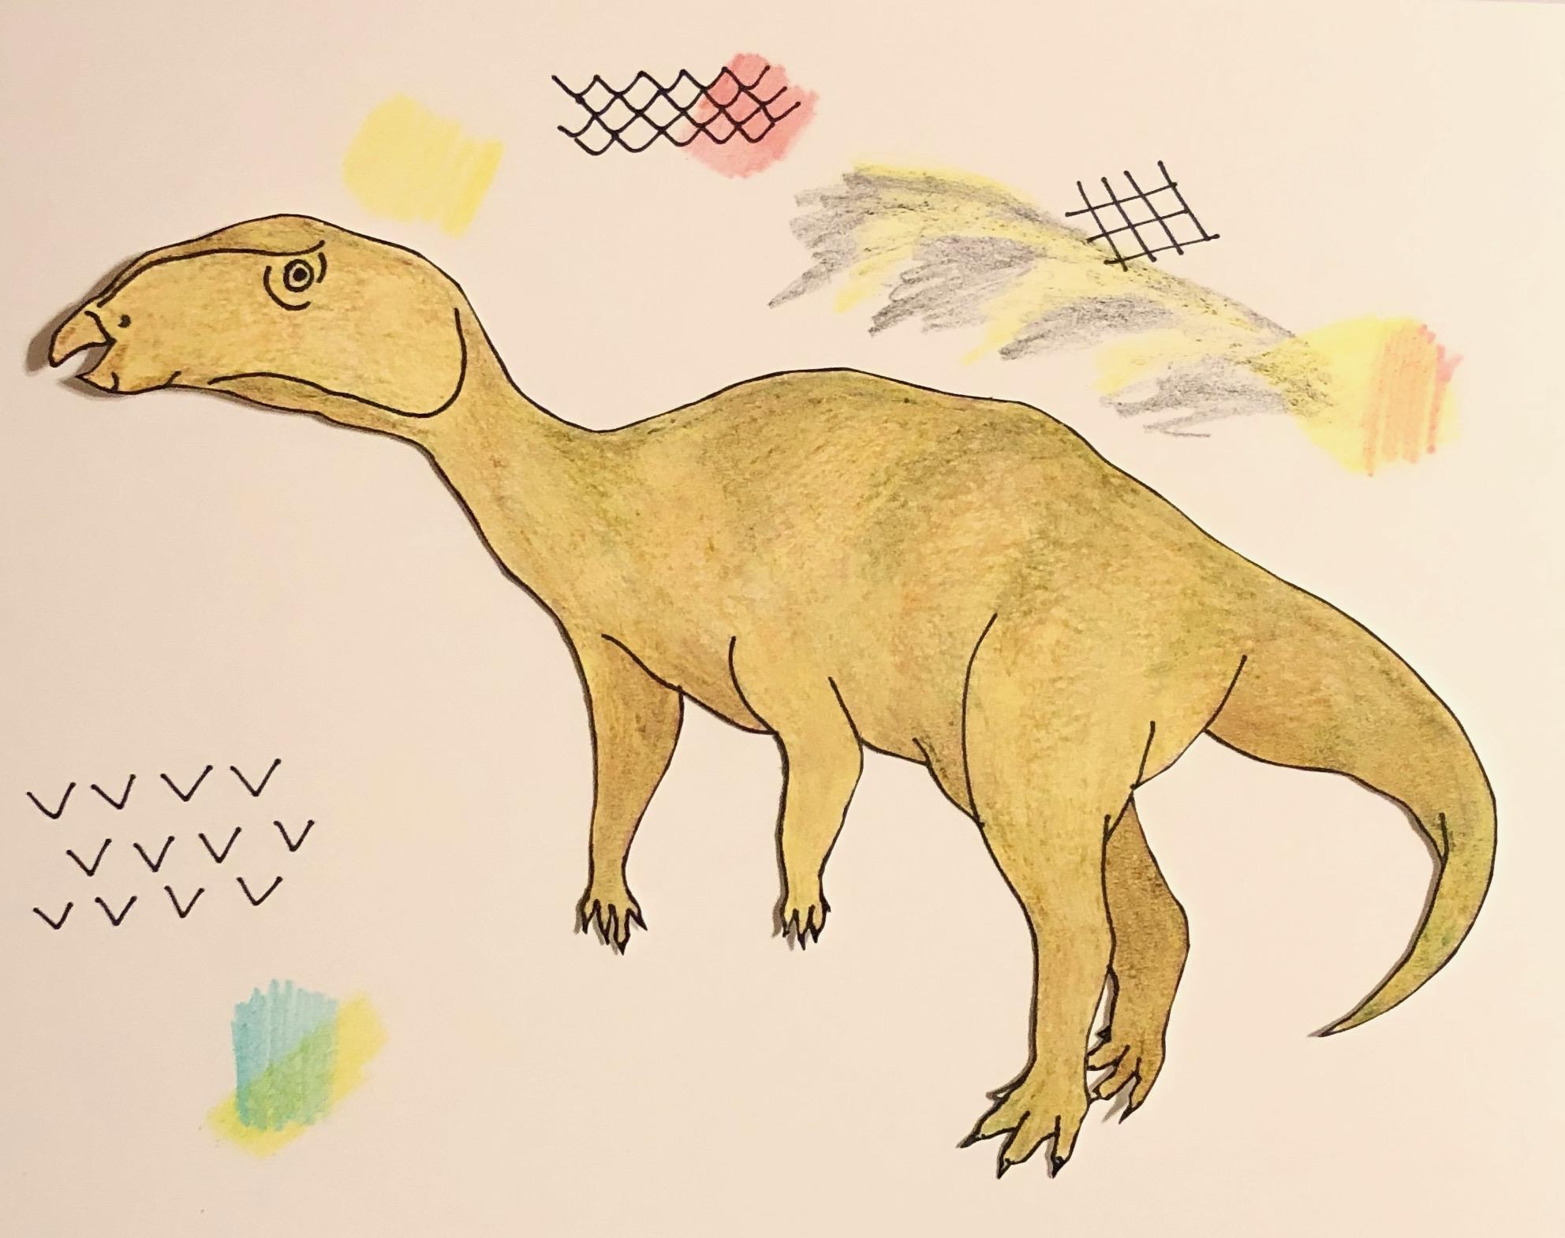
EXAMPLE Begin Bringing Your Organism Back To Life Part #2
Using something as a backlight such as a flashlight or a window sketch your organism from Part #1 on the previous page here. Test different color patterns and options to decide what best fits your organism. Use multiple versions of this page if need be. If you’re doing this electronically, paste an image of your drawing here and try out different colorations.
Images by Beverly Owens

Slide 22
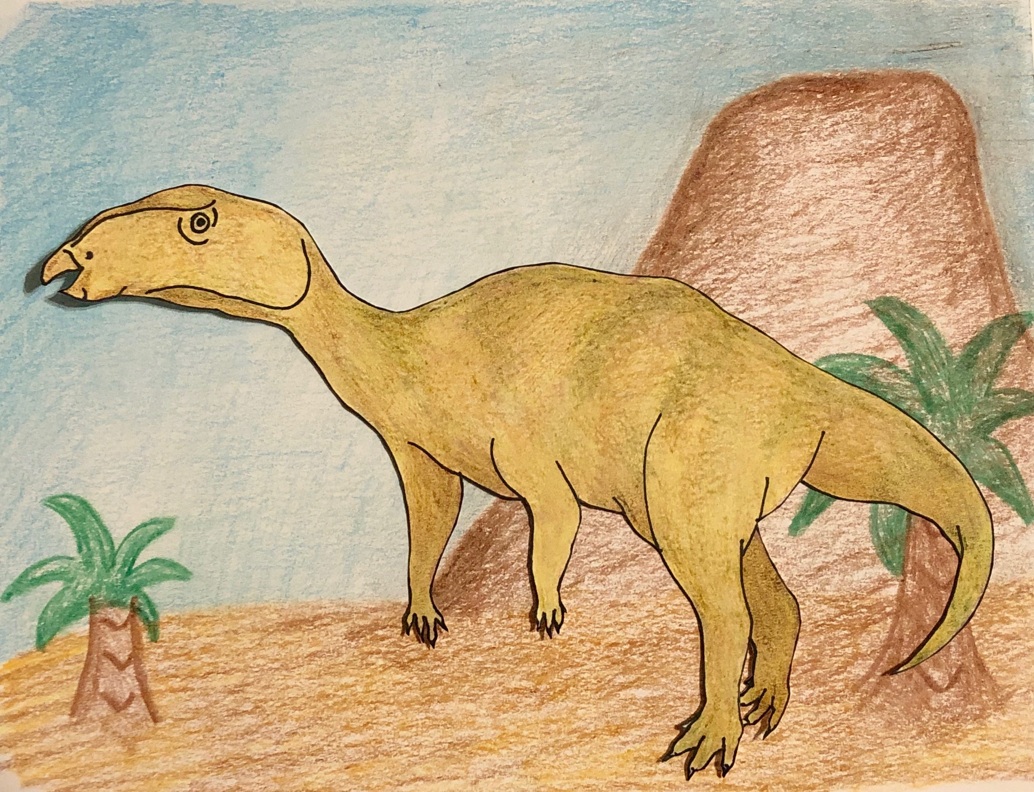
EXAMPLE Begin Bringing Your Organism Back To Life Part #3
Create your organism here. You can sketch it and add your chosen color scheme, or you can copy and paste the drawing you like best from the last set of slides. Then apply the appropriate environment to complete your paleoart. Be sure to keep in mind your earlier research about what it ate, the environment it lived in, the shape of its body, and other features that might give you a clue to how it lived and where it lived.
Images by Beverly Owens

Slide 23
Reflection
Why do you think artistic depictions of organisms like dinosaurs have changed so much over the past 100 years?
In your opinion why do paleoartists today have such a wide range of depictions of the same organism if the same information and research is available to everyone?

Slide 24
Reflection
What was the most difficult part of creating paleoart of your organism?
Knowing you can’t hop in your time machine to find out if your paleoart is 100% accurate, what piece or pieces of information do you wish you could find that to make your paleoart more accurate?

Slide 25
Reflection
How did the experience of this project change your ideas about the importance of fossil evidence in understanding our environment today? Use evidence from your experience to help support your point.
How did the experience of this project change your ideas about the importance of fossil evidence in understanding creatures that are alive in the modern day? Use evidence from your experience to help support your point.

