Slide 1
Hungry Hungry Hermetia
Student Name:
Resource By Brian Soash
Resource by Brian Soash

Slide 2
Now Let’s Set A Baseline
Setting a baseline can give you a threshold to compare the success of your design. The following pages will help you set a baseline using the results from your class experiment. You’ll be finding the following to help you come up with a way to create a successful final design:
Daily waste created per student in class
Waste consumed per hour by the larvae
Waste consumed per larvae per hour
Waste consumed per cubic centimeter of space of a container
On the next page you’ll find an example of how to use a proportion to solve for an unknown

Slide 3
EXAMPLE #1 Baseline Classroom Daily Food Waste Calculation
In one day our class created a total of:
64
grams of food waste.
Our classroom has a total of:
30
students
grams of food waste per day by the whole class
number of grams of food waste in a day by a single student
64
x
total students in our class
student
There are many ways to set up a proportion to solve for an unknown!
30
1
30
x
64
30
x
64
2.133...
grams of food waste per student every day
30
30

Slide 4
EXAMPLE #2 Baseline Classroom Daily Food Waste Calculation
In one day our class created a total of:
64
grams of food waste.
Our classroom has a total of:
30
students
grams of food waste per day by the whole class
total students in our class
64
30
number of grams of food waste in a day by a single student
student
There are many ways to set up a proportion to solve for an unknown!
x
1
30
x
64
30
x
64
2.133...
grams of food waste per student every day
30
30

Slide 5
EXAMPLE #3 Baseline Classroom Daily Food Waste Calculation
In one day our class created a total of:
64
grams of food waste.
Our classroom has a total of:
30
students
number of grams of food waste in a day by a single student
x
1
student
grams of food waste per day by the whole class
total students in our class
There are many ways to set up a proportion to solve for an unknown!
64
30
30
x
64
30
x
64
2.133...
grams of food waste per student every day
30
30

Slide 6
EXAMPLE #4 Baseline Classroom Daily Food Waste Calculation
In one day our class created a total of:
64
grams of food waste.
Our classroom has a total of:
30
students
number of grams of food waste in a day by a single student
1
x
student
total students in our class
grams of food waste per day by the whole class
There are many ways to set up a proportion to solve for an unknown!
30
64
30
x
64
30
x
64
2.133...
grams of food waste per student every day
30
30

Slide 7
EXAMPLE #5 Baseline Classroom Daily Food Waste Calculation
In one day our class created a total of:
64
grams of food waste.
Our classroom has a total of:
30
students
1
30
total students in our class
student
number of grams of food waste in a day by a single student
grams of food waste per day by the whole class
There are many ways to set up a proportion to solve for an unknown!
x
64
30
x
64
30
x
64
2.133...
grams of food waste per student every day
30
30

Slide 8
EXAMPLE #6 Baseline Classroom Daily Food Waste Calculation
In one day our class created a total of:
64
grams of food waste.
Our classroom has a total of:
30
students
grams of food waste per day by the whole class
total students in our class
30
64
number of grams of food waste in a day by a single student
There are many ways to set up a proportion to solve for an unknown!
student
1
x
30
x
64
30
x
64
2.133...
grams of food waste per student every day
30
30

Slide 9
Directions:
Finding Your Baseline!
After seeing some example calculations on the previous pages, use the information from your whole class example to determine the baseline data for your class. You’ll use this baseline as a benchmark to try and top when creating your own design to reduce cafeteria food waste.
You’ll notice that the variable is place in a different location on each page. Use your knowledge of proportion to solve for the unknown provided in each location to determine the specific rate for each page. Feel free to check back to the example on the previous pages if you want a refresher. Keep in mind, there is more than one way to correctly set up these problems to solve for the desired rate on each page.
Place your finding on page 15!
Let’s get started! How many grams of food were consumed by the 100 black soldier fly larvae in a day when you tried this as a class?
grams

Slide 10
Baseline Classroom Daily Food Waste Calculation
In one day our class created a total of:
grams of food waste
Our classroom has a total of:
students
x
Place your finding on page 15!
x
x
64
grams of food waste per student every day

Slide 11
Baseline Of How Many Grams Of Food Consumed By Fly Larvae Per Hour
In one day the larvae consumed:
grams
Out of a total:
grams
x
Place your finding on page 15!
x
x
of grams consumed per hour by all of the larvae
Notes:
Solving for (oz/hr)

Slide 12
Baseline Daily Rate Consumed Per Larva
In one day the larvae consumed:
grams
Out of a total:
100
Larvae
x
Place your finding on page 15!
x
x
of grams consumed per larvae per day

Slide 13
Baseline Number Of Larvae Needed To Consume All The Daily Waste For One Class
Number of grams of waste created each day by the class
In one day the larvae consumed:
grams per hour
Out of a total:
Larvae
grams
x
Place your finding on page 15!
x
x
of larvae needed to eliminate an entire class’s daily food waste

Slide 14
Baseline Rate Per Cubic Centimeter Of Space In Container
In one day the larvae consumed
Volume of container
Length of the container
Width of the container
Height of the container
(Link provided to help you find the volume depending on the type of shape of your container)
grams
cm
cm
cm
cm^3
x
Place your finding on page 15!
x
x
of grams consumed per cubic centimeter of space per hour

Slide 15
Baseline Data Vs. Your Design
Baseline From Your Class Experiment
Number Of Grams Consumed In 24 Hours | Grams Per Hour Consumed By All Larvae | Grams Consumed Per Day Per Larvae | Number Of Larvae Used | Grams Of Food Consumed Per cm^3
________ grams | ________ grams | ________ grams | ________ larvae | ________ cm^3
*Remember, your aim should be able to handle the amount of food waste generated to handle the waste of one student per day. It’s Ok to use more larvae than the control, but you want to aim to be as efficient in your use of space and larvae as possible.
Results From Your Design
Number Of Grams Consumed In 24 Hours | Grams Per Hour Consumed By All Larvae | Grams Consumed Per Day Per Larvae | Number Of Larvae Used | Grams Of Food Consumed Per cm^3
________ grams | ________ grams | ________ grams | ________ larvae | ________ cm^3
Which Is Better?
Number Of Grams Consumed In 24 Hours | Grams Per Hour Consumed By All Larvae | Grams Consumed Per Day Per Larvae | Number Of Larvae Used | Grams Of Food Consumed Per cm^3
Baseline/My Design | Baseline/My Design | Baseline/My Design | Baseline/My Design | Baseline/My Design

Slide 16
What I Think...
Do you eat everything you pick up from the cafeteria or bring from school? | I think I probably throw out about _______ grams of food each day (keep in mind 1 pound. is 453.592 grams). For a perspective of what 5 grams of food looks like check out the next page. | What do you think would be the easiest way to reduce the amount of food waste from your school knowing not everyone will always eat all their food?

Slide 17
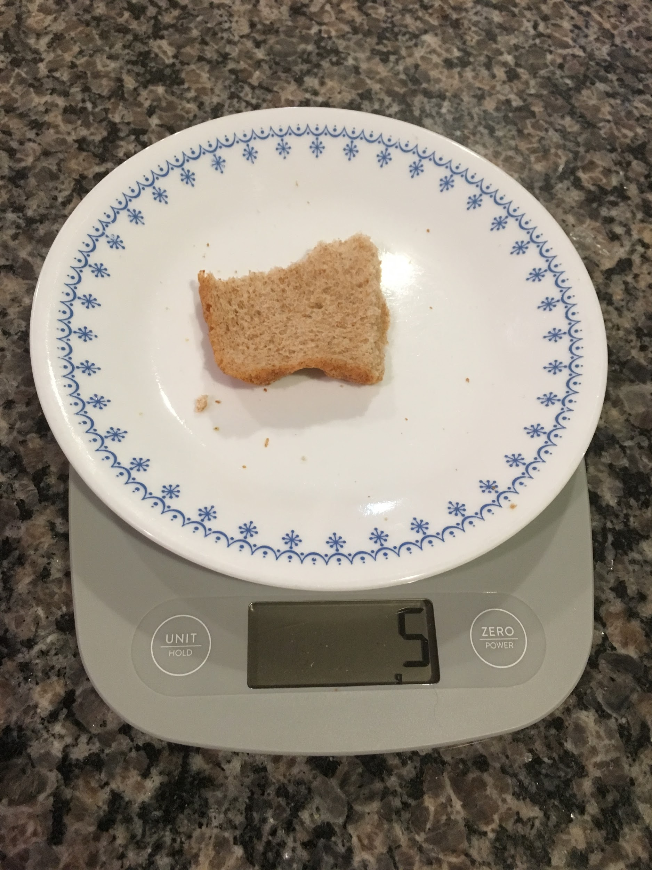
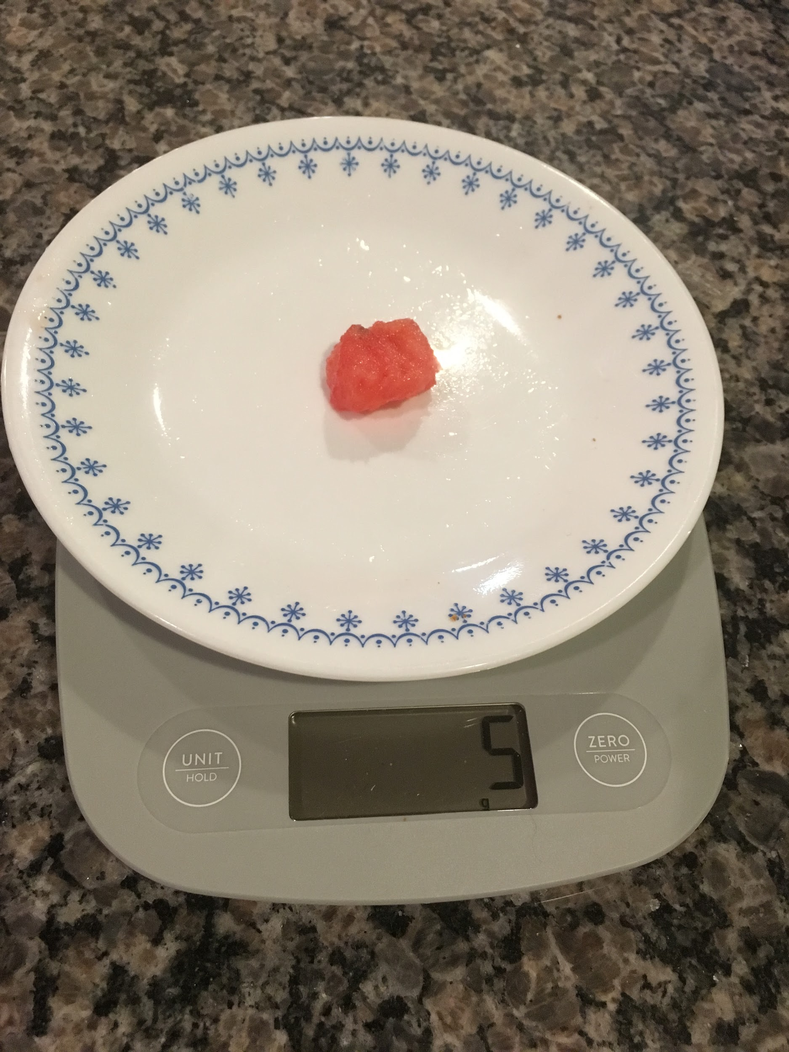
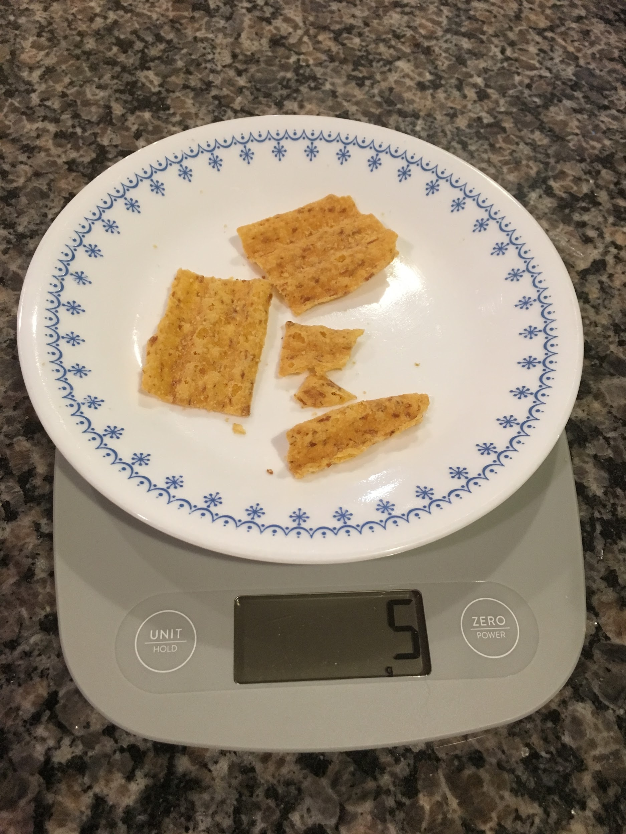
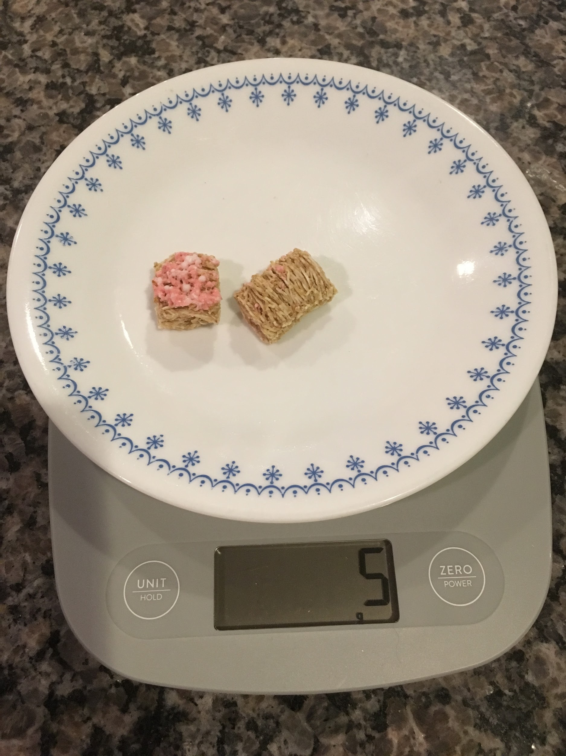
What Does A Gram Of Food Look Like?
5 grams of food is about a quarter of a slice of bread
5 grams of food is a small piece of watermelon
5 grams of food is a small pile of chips
5 grams of food is about 2 pieces of shredded wheat cereal

Slide 18
Team Name:
Pick a team of classmates to participate in this project with you!
Person Number #1
Person Number #2
Person Number #3
Notes:
In this section include the name the team, the names of the team members, and the roles and responsibilities of everyone involved. This can be modified later on in the project if need be.

Slide 19
Driving Question
Can the food waste produced by our school be eliminated using black soldier fly larvae instead of being sent to the dump?

Slide 20
Why is the driving question from the previous page so important to your group?

Slide 21
Information Needed To Solve The Problem
What pieces of information do you need to solve this problem? | Explain why you need this piece of information.
Notes:
Use the templates below to discuss with your group the type of information you believe you might need in order to solve this problem and how it will aid you in coming to your conclusion.

Slide 22
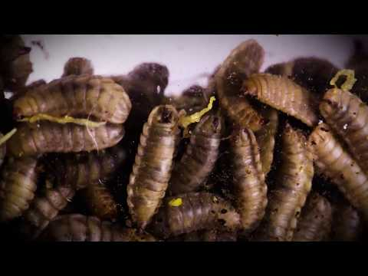
Science Friday Inspiration

Slide 23
Recording the Data.
How many grams of food were thrown away by the entire class in the day you collected food waste from the cafeteria?
How much food did each person in the class throw away today? Calculate the average amount of food waste per person from your class. To do this, divide the total weight of the food by the number of people in the class who contributed today. *It’s ok that not everyone eats the same amount, the same thing, or the same way. This number is an average, and will be used is simply to create a baseline for your study.
How much food do you think that your class sends to a landfill in a month? In a school year?

Slide 24
Think about it...
With your team, brainstorm some ideas for reducing the amount of food waste from your school.

Slide 25
Your Larvae Composting Design
Sketch Your Design Electronically Or Upload A Photo Of Your Hand Drawn Sketch
How Will It Work?
How Many Larvae Will Be Used

Slide 26
Describe the process
Explain in the section below how you and your group ultimately created your design. Be sure to provide specific details such as the order you did things, what pieces were connected where, and anything you made sure you did or didn’t do to achieve your desired end result.

Slide 27
Insert Picture Of Your Finished Design Here

Slide 28
Prediction: Waste Consumed In 24 Hours In Your Design
Number of grams predicted to be consumed by your larvae in 24 hours | Reasoning for prediction.
Was your prediction correct? | If your prediction was incorrect, what was is your reasoning for why you over or underestimated? If your prediction was correct, how could you improve your design based on your observations?

Slide 29
How Many Grams Of Food Consumed By Fly Larvae Per Hour
In one day the larvae consumed:
grams
grams
Out of a total:
x
Place your finding on page 15!
x
x
of grams consumed per hour by all of the larvae
Notes:
Solving for (oz/hr) (grams/hr)

Slide 30
Daily Rate Consumed Per Larva
In one day the larvae consumed:
grams
Out of a total:
100
Larvae
x
Place your finding on page 15!
x
x
of grams consumed per larvae per day

Slide 31
Number Of Larvae Needed To Consume All The Daily Waste For One Class
Number of grams of waste created each day by the class
In one day the larvae consumed:
grams per hour
Out of a total:
Larvae
grams
x
Place your finding on page 15!
x
x
of larvae needed to eliminate an entire class’s daily food waste

Slide 32
Rate Per Cubic Centimeter Of Space In Container
In one day the larvae consumed
Volume of container
Length of the container
Width of the container
Height of the container
(Link provided to help you find the volume depending on the type of shape of your container)
grams
cm
cm
cm
cm^3
x
Place your finding on page 15!
x
x
of grams consumed per cubic centimeter of space per hour

Slide 33
Information For In Class Review
What rate did was your food consumed? | How many larvae did you use?
How long would it take for the larvae in your design to consume the entire food waste from a single person? | Unique aspects of your design?

Slide 34
Summary Of Feedback From Presentation
Review the feedback you received from your classmates. In what areas did your group do well? In what areas did your classmates think you needed to focus more?

Slide 35
Results From Other Groups
Collect information from each group’s presentation to make calculations
Team Number | Things To Replicate From Their Work | Lessons Learned From Their Work | Rate Of Food Consumed Per 24 Hours | Number Of Larvae Used
#1 |  |  | Grams per day
#2 |  |  | Grams per day
#3 |  |  | Grams per day

Slide 36
Results From Other Groups
Team Number | Things To Replicate From Their Work | Lessons Learned From Their Work | Rate Of Food Consumed Per 24 Hours | Number Of Larvae Used
#4 |  |  | Grams per day
#5 |  |  | Grams per day
#6 |  |  | Grams per day

Slide 37
Results From Other Groups
Team Number | Things To Replicate From Their Work | Lessons Learned From Their Work | Rate Of Food Consumed Per 24 Hours | Number Of Larvae Used
#7 |  |  | Grams per day
#8 |  |  | Grams per day
The group with the best rate was group |  | ____ with a rate of | ____ grams. per day

Slide 38
Proportional Relationships
Dr. Hu states in the video(2:07 mark) that the ratio of food consumed to number of larvae is not proportional. Based on the results from your class, work as a group to determine whether your data confirm or disprove his claim?
Group | 1 | 2 | 3 | 4 | 5 | 6 | 7 | 8
Number Of Larvae Used
Grams Of Food Consumed Within 24 Hours

Slide 39
Proportional Relationships
Dr. Hu states in the video(2:07 mark) that the ratio of food consumed to number of larvae is not proportional. Based on the results from your class, does your data confirm or disprove his claim?
Is the ratio of larvae used to grams consumed between group 1 and 2 proportional? |  | Is the ratio of larvae used to grams consumed between group 3 and 4 proportional? |  | Is the ratio of larvae used to grams consumed between group 5 and 6 proportional? |  | Is the ratio of larvae used to grams consumed between group 7 and 8 proportional?
Work using proportions
=
=
=
=
Answer
=
=
=
=
Are the ratios proportional? | Yes No |  | Yes No |  | Yes No |  | Yes No

Slide 40
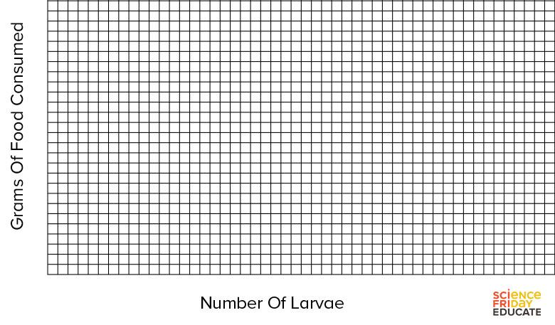
Proportional Relationships
Graph your results from the previous page to discover whether or not the ratio of number of larvae to grams of food waste consumed form a proportional relationship!

Slide 41
Information For Design Fair Infographic
What rate did was your food consumed? | How many larvae did you use?
How long would it take for the larvae in your design to consume the entire food waste from a single person? | Unique aspects of your design? | Describe how your design is an efficient use of space, larvae, and materials that may set it apart from other successful designs.

Slide 42
Information For Design Fair Infographic Part 2
Describe what about this method you thought would be the most successful. | What makes this solution something that could have been scaled? | What improvements could be made based on your results?

Slide 43
Conclusion Question
These questions should be answered individually
Did the rates of grams of food consumed every 24 hours and the number of larvae use between groups form a proportional relationship? Use the graph and your calculations as evidence to support your claim.
Based on the rates determined from your testing, how many larvae would it take to consume one day of food waste generated by your class in only 24 hours?

Slide 44
Conclusion Question
Based on your testing results, how many cubic centimeters of space would be required to eliminate the food waste from your whole class?
Ask your teachers for the number of classrooms in your school. How many larvae would be needed to eliminate all the food waste created at your school within 24 hours if you assumed every classroom produced the same amount of daily food waste as your class?

Slide 45
Conclusion Questions
Based on your testing results how many cubic centimeters of space would be required to eliminate the food waste from your whole school?
Companies like Fluker’s sell Black Soldier Fly Larvae as food for reptile and amphibian pets. Based on the current price charged by this company for 1,000 of their larvae, how much money could your school raise if you sold half of the larvae required in question #6 every two weeks? How much money could your school raise in a month? How much in a 10 month school year?

Slide 46
Reflection
In your opinion what design features made a design successful? Are there features that didn’t work as planned? How would you change them?
In your opinion, is the problem of food waste at your school something that can be solved by any of the designs generated by your class?

Slide 47
Reflection
In your opinion, is using Black Soldier Fly larvae as a means of recycling food waste a reasonable solution? What will you do with all the adult flies leftover?

Slide 48
Rubric For Each Reflection Question
Criteria | 3 | 2 | 1
Claim | Claim is stated explicitly and is easily found as the first component of the student’s answer. | Claim is stated using any indirect manner at the start of a student’s answer. | Claim is not clear and/or is not the first component of a student’s answer.
Evidence | Student uses evidence directly from the work or findings from the activity. The student explicitly states where the evidence can be found and where it came from. | Student uses evidence directly from the work or findings from the activity. There is no citation provided to where that information can be found. | Student uses no evidence or uses strictly anecdotal evidence not from the activity.
Reasoning | Reasoning is provided that directly supports the claim and uses the evidence previously provided. Reasoning is provided after the evidence and is not simply the evidence provided. | Reasoning provided is simply the statement of the evidence without further explanation or reasoning provided is flawed. | Reasoning provided does not directly relate to the evidence supported or is inaccurate

