Slide 1

Binary Conversion
Resource by Andrea LaRosa

Slide 2

How Exactly Does BINARY CODE Work?

Slide 3
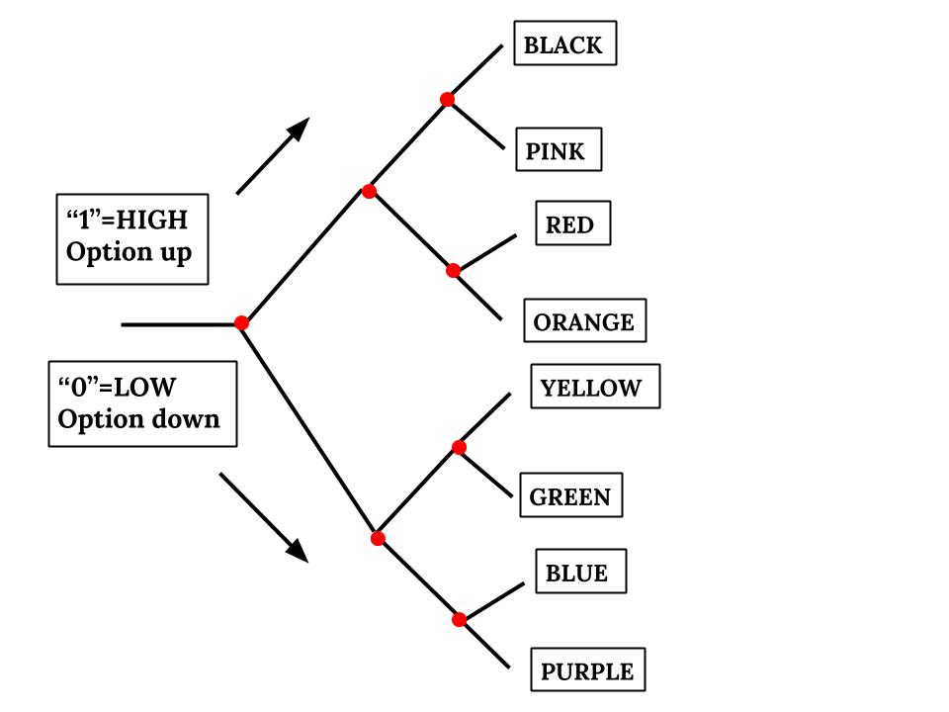
Your Task
In this activity, you will act as digital-analog converters to decode binary pulses into colored pixels. You’ll use binary coding to represent pathways through a series of “high” and “low” choices, which represent the path to take on a logic map:

Slide 4
Let’s Practice
Binary sequence:
010
Identify the color:

Slide 5
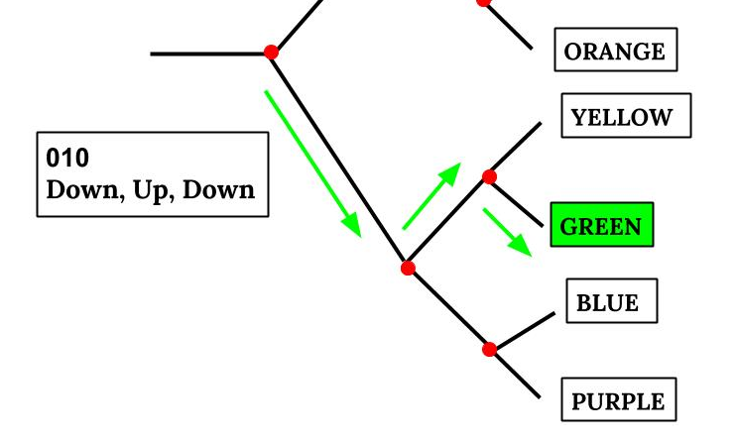
Let’s Practice
Binary sequence:
010
Identify the color:
GREEN

Slide 6
Your Turn:
Binary sequence:
111
Identify the color:

Slide 7
Your Turn:
Binary sequence:
111
Identify the color:
Up, up, up
BLACK

Slide 8
Let’s try a longer
sequence
Binary sequence:
101011110
Identify the colors:

Slide 9
Let’s try a longer
sequence
Binary sequence:
101011110
Identify the colors:
Red Yellow Pink

Slide 10
Now let’s convert given a digital wave
Binary sequence:
*Note: only the horizontal lines represent the values 1 or 0. The vertical lines show the movement between the horizontal lines.
Identify the color:
1
0

Slide 11
Now let’s convert given a digital wave
Binary sequence:
Identify the color:
110 Up, Up, Down
PINK
1
0

Slide 12
Your Turn
Binary sequence:
Identify the color:
1
0

Slide 13
Your Turn
Binary sequence:
Identify the color:
101 Up, Down, Up
RED
1
0

Slide 14
Let’s try a longer
sequence
Binary sequence:
Identify the colors:
1
0

Slide 15
Let’s try a longer
sequence
Binary sequence:
Identify the colors:
111011101
Black Yellow Red
1
0

Slide 16
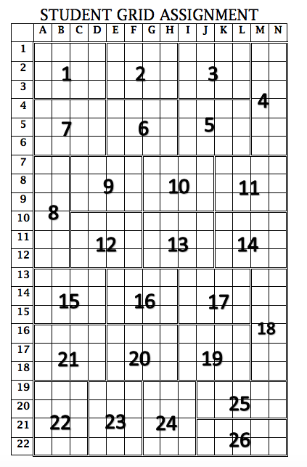
Our Task
As a class, we will decode a series of binary sequences to create a Post-It mosaic.
Each student is responsible for decoding a section of the grid.

Slide 17
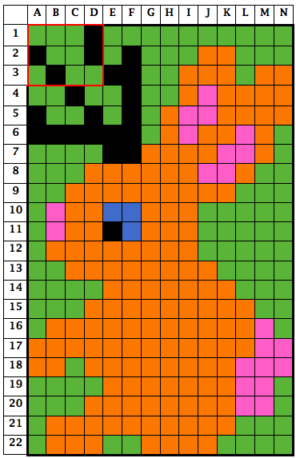
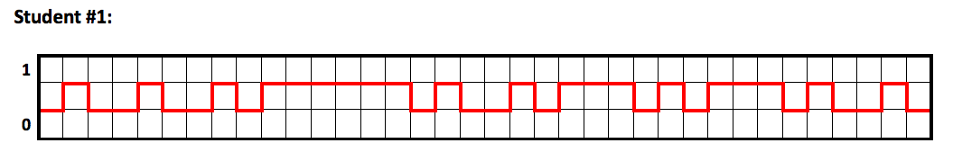
Example (not your mosaic)
You will get your own sequence graph:
Use the logic map--> to decode your color
Student 1
Cell # | Binary | Color
A1 | 010 | Green
B1 | 010 | Green
C1 | 010 | Green
D1 | 111 | Black
A2 | 111 | Black
B2 | 010 | Green
C2 | 010 | Green
D2 | 111 | Black
A3 | 010 | Green
B3 | 111 | Black
C3 | 010 | Green
D3 | 010 | Green

Slide 18
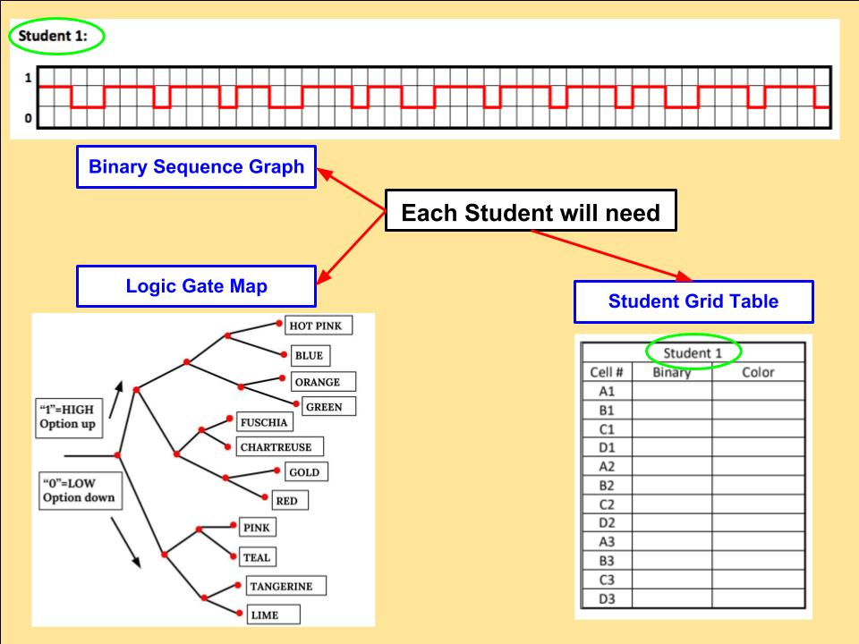
Student Set-Up
Make sure your binary sequence and grid table match.
Student 1
Sequence Graph
&
Student 1
Grid Table

Slide 19
Check your work with your teacher before adding your Post-Its to the mosaic.
Color
Hot Pink
Blue
Orange
Green
Fuchsia
Olive
Gold
Red
Pink
Teal
Tangerine
Lime

Slide 20
