Slide 1

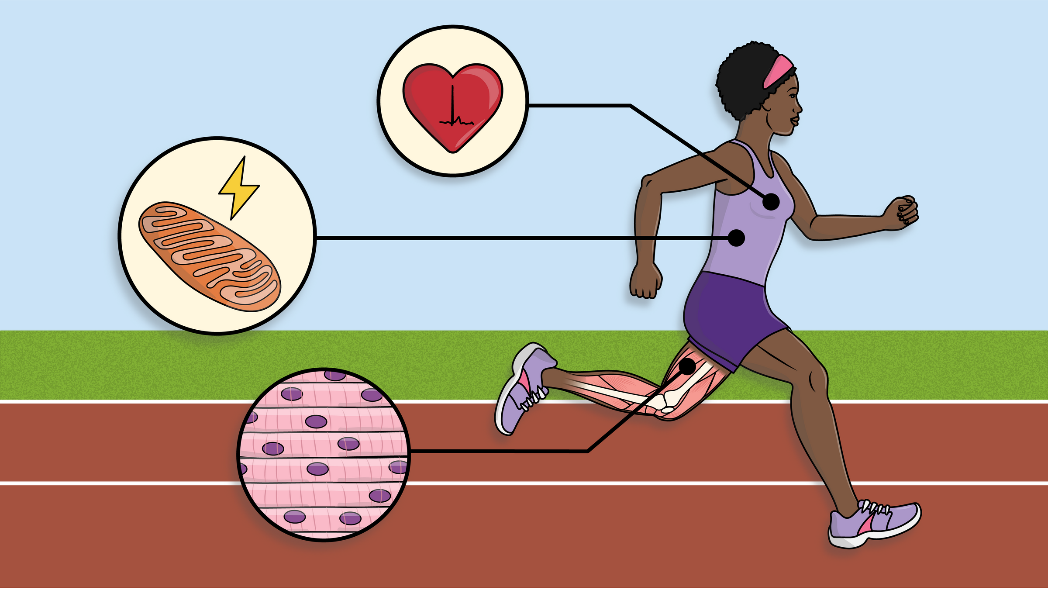
What Makes A Super Athlete?
Look A Little Closer

Slide 2
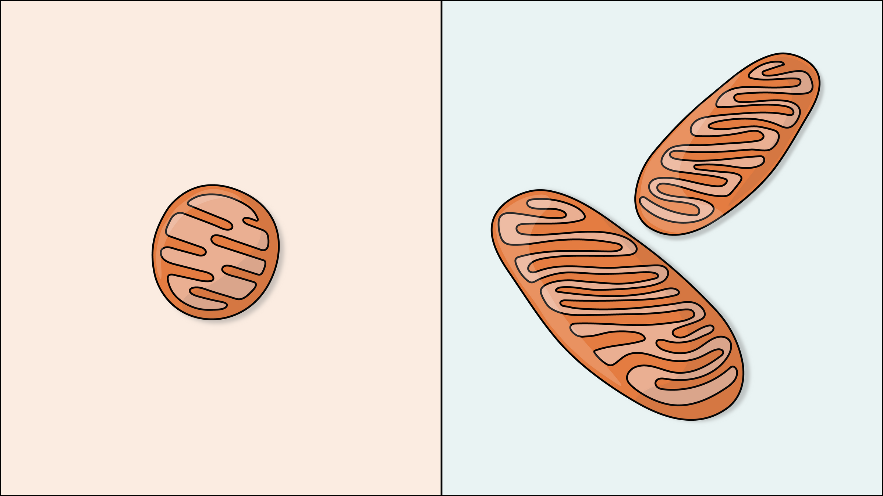

Organelle: Mitochondria
Internal structure
Internal structure
Average
Athlete
Notes:
Athletes' muscle tends to contain more and larger mitochondria, which allows the cells to generate more chemical energy. In addition, research shows that there are differences in the internal structure of mitochondria in athletes. It's more dense, which can increase energy production by up to 25%.
Read more at: https://www.eurekalert.org/news-releases/551606

Slide 3
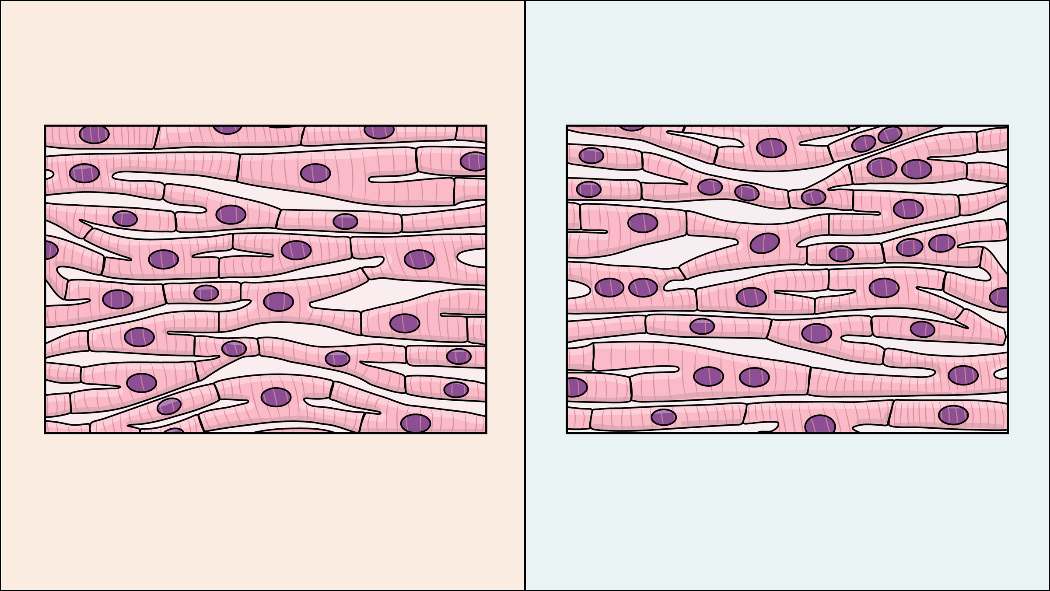
Tissue: Cardiac Muscle
Cell nuclei
Cell nuclei
Average
Athlete
Notes:
Most cardiac muscle has one nucleus per cell. The purple spots in this image are nuclei. Nuclei are like the command center for the cell. They control everything that happens in the cell, including replication—when the cell makes more cells like itself. Having more nuclei in their cardiac muscle means that an athlete can make cells more quickly, which allows them to easily repair damage and build more muscle mass. As a result, they may have a stronger, more efficient heart. Skeletal muscle benefits from extra nuclei in the same way. Plus, researchers are discovering that even when an athlete stops training they retain the extra nuclei, which means it's easier for them to repair and grow muscle later.
Read more at: https://www.sciencedaily.com/releases/2019/01/190125084106.htm

Slide 4
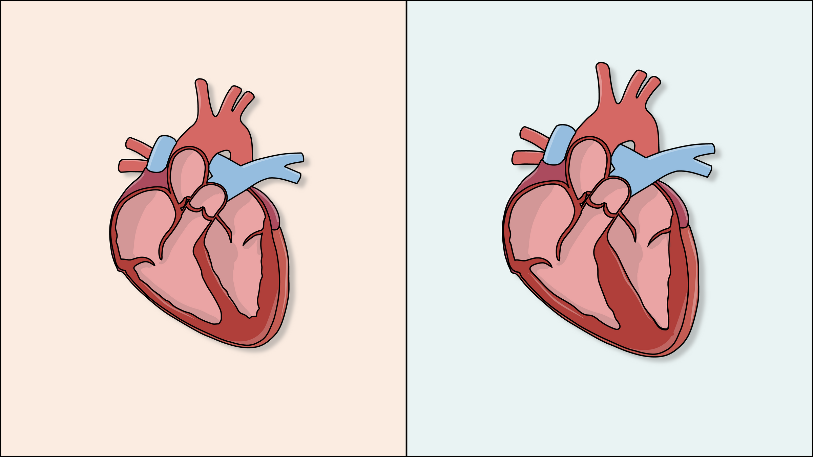
Organ: Heart
Muscle tissue
Muscle tissue
Average
Athlete
Notes:
A great deal of athleticism depends on a healthy and strong heart that can efficiently pump oxygen-rich blood and nutrients to the skeletal muscles. Muscles in the arms and legs need oxygen to make energy. So a strong heart provides other muscles with what they need to react quickly, strongly, and for a longer period of time. The more exercise it gets, the more mass it builds and the more strength it has.
Some who participate in intense endurance sports can develop athletic heart syndrome, where the left ventricle becomes larger and the muscle thicker. This isn't usually dangerous, but doctors do monitor the condition just in case.
Read more at: https://my.clevelandclinic.org/health/diseases/23920-athletes-heart

Slide 5
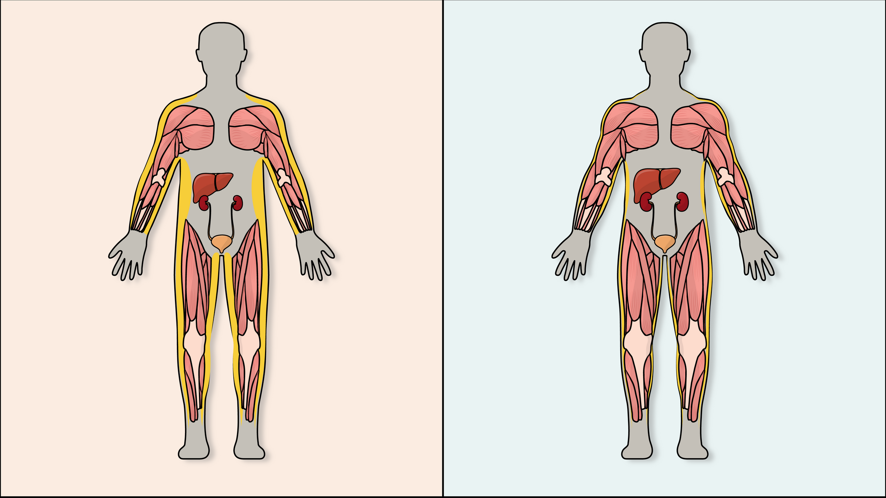
Organ Systems
Fat tissue
Fat tissue
Liver
Liver
Kidneys
Kidneys
Muscle tissue
Muscle tissue
Average
Athlete
Notes:
Athletes' bodies tend to have less fat tissue and more muscle than an average person. Athletes also tend to have larger livers and kidneys. In the case of the liver, this may contribute to better metabolism—the process that the body uses to change food into energy.
Read more at: https://pubmed.ncbi.nlm.nih.gov/17133285/

Slide 6
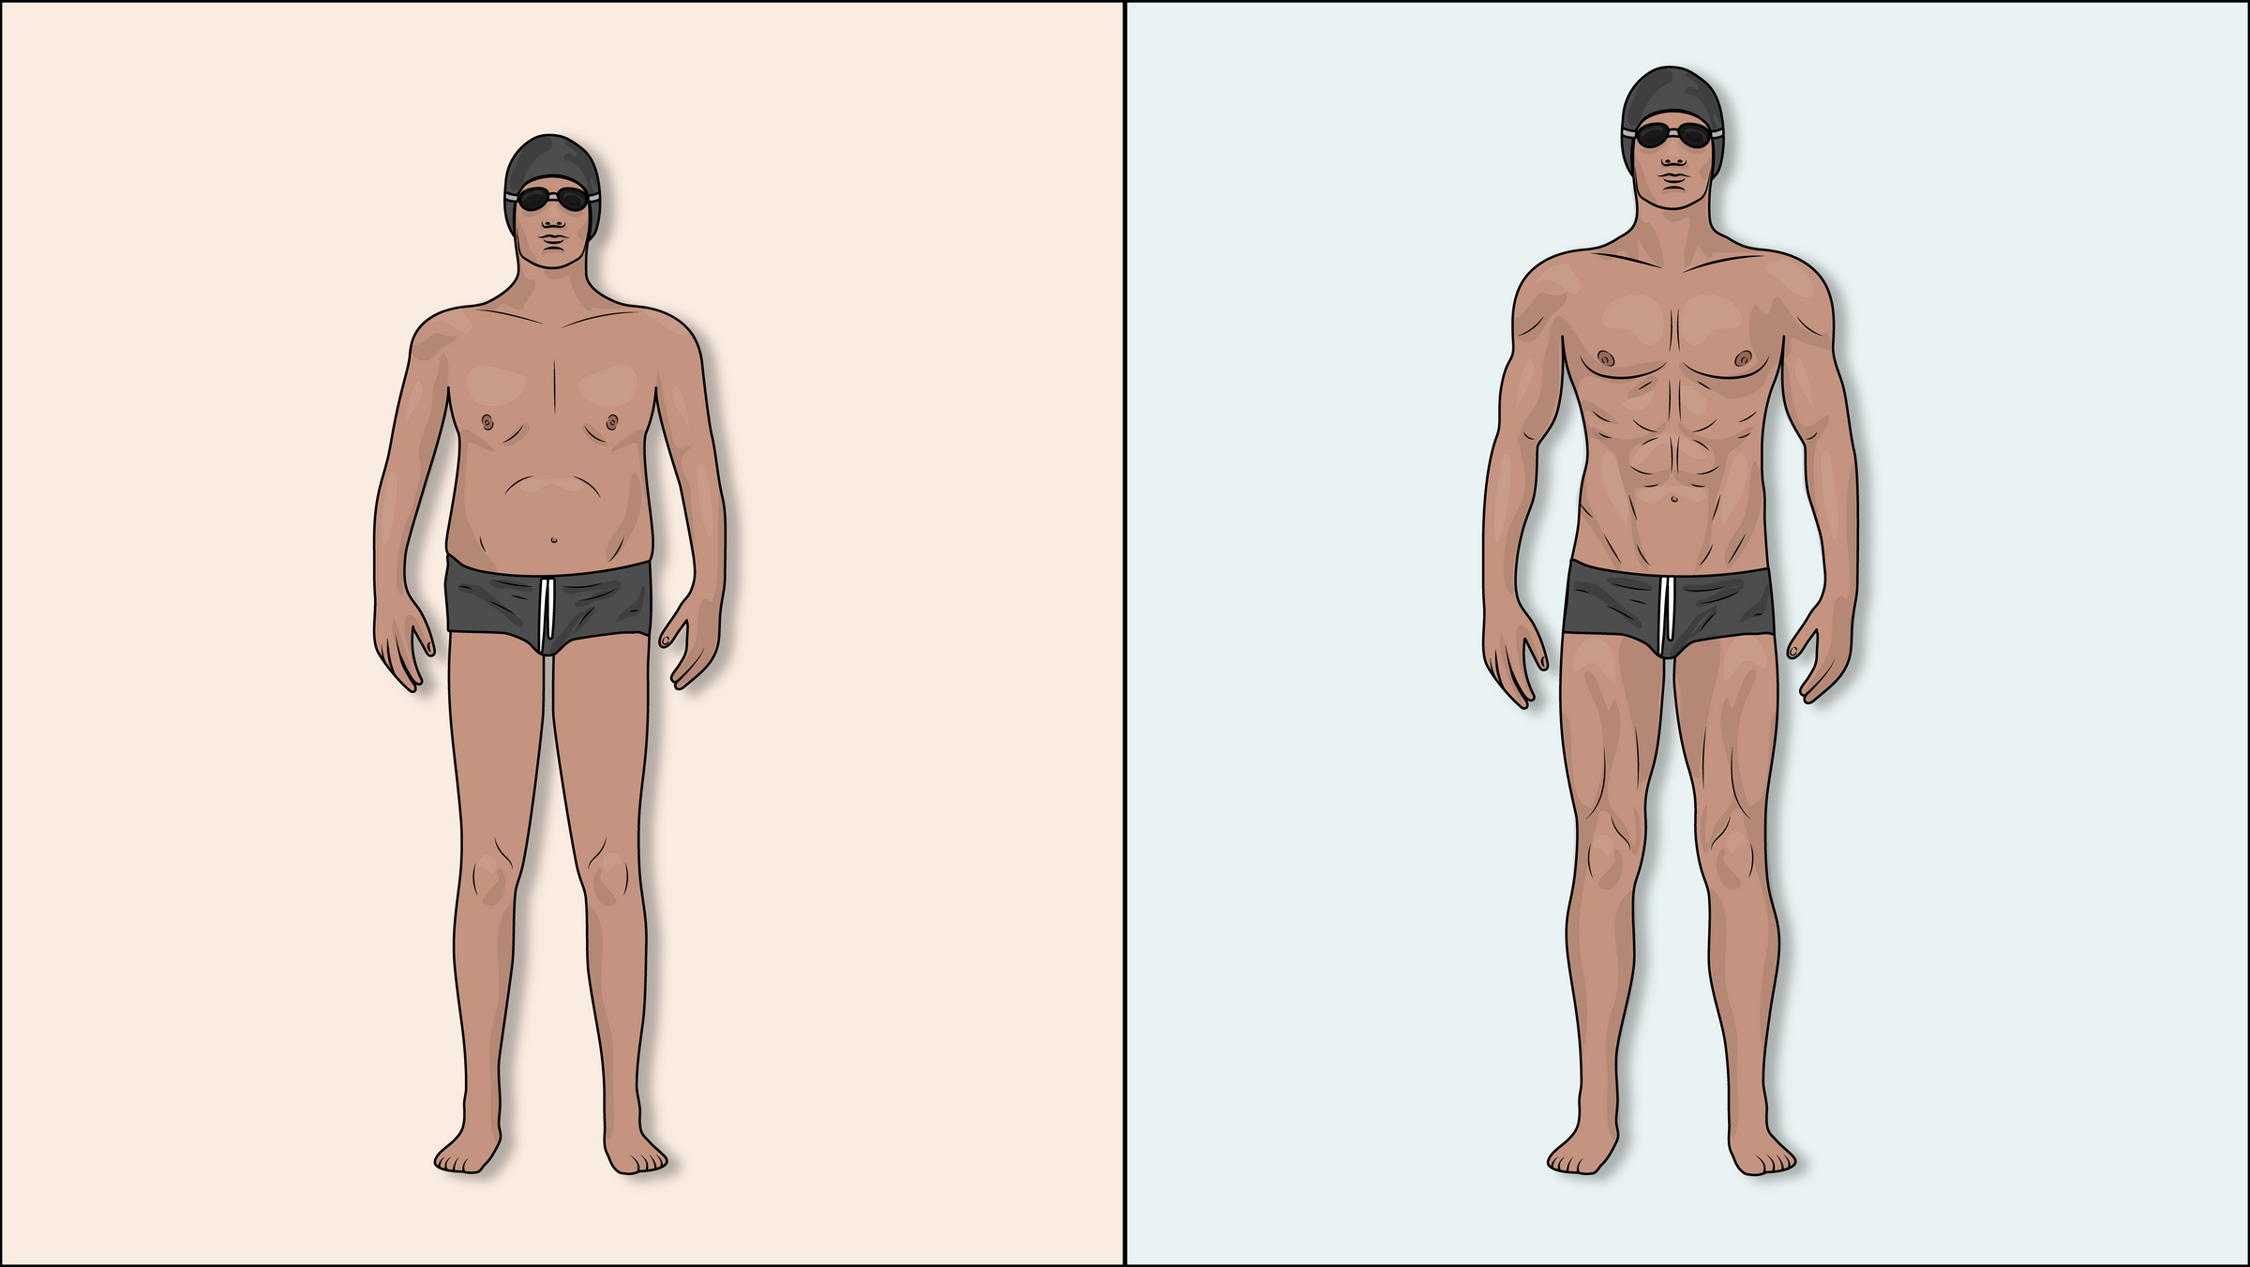
Full Body Features
Total height
Arm length
Torso length
Leg length
Average
Athlete
Notes:
In addition to having more muscle, athletes like Michael Phelps have other advantages. For example, he has longer-than-average arms. His torso is also proportionally longer as compared to his legs. These genetic advantages help to make him an excellent swimmer.
Read more at: https://www.businessinsider.com/michael-phelps-rio-olympics-body-swimming-2016-8

