Slide 1
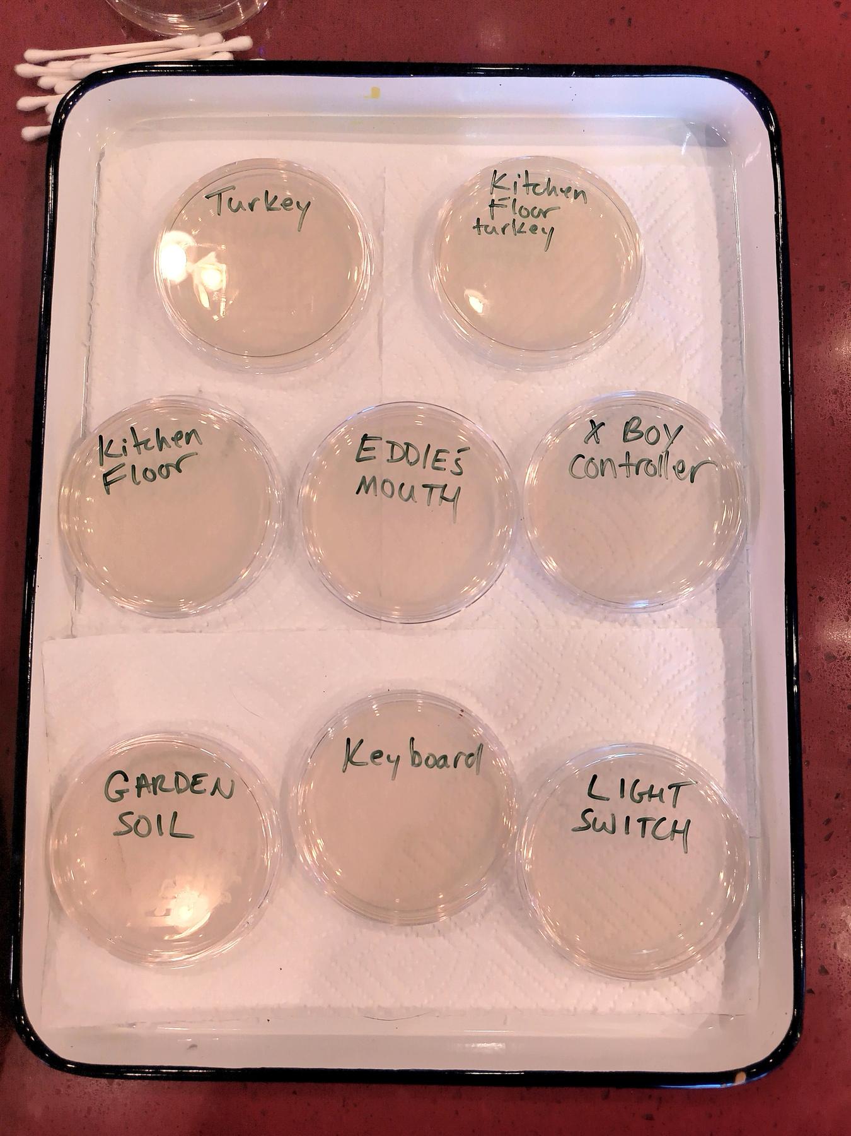

Choose surfaces to swab.
Prepare your agar plates. Label your agar plates by writing the names of the surfaces you’re testing on the bottom of the plate. (After you swab your test samples, you will be placing the plates face down so that no condensed water drips into your sample.)

Slide 2
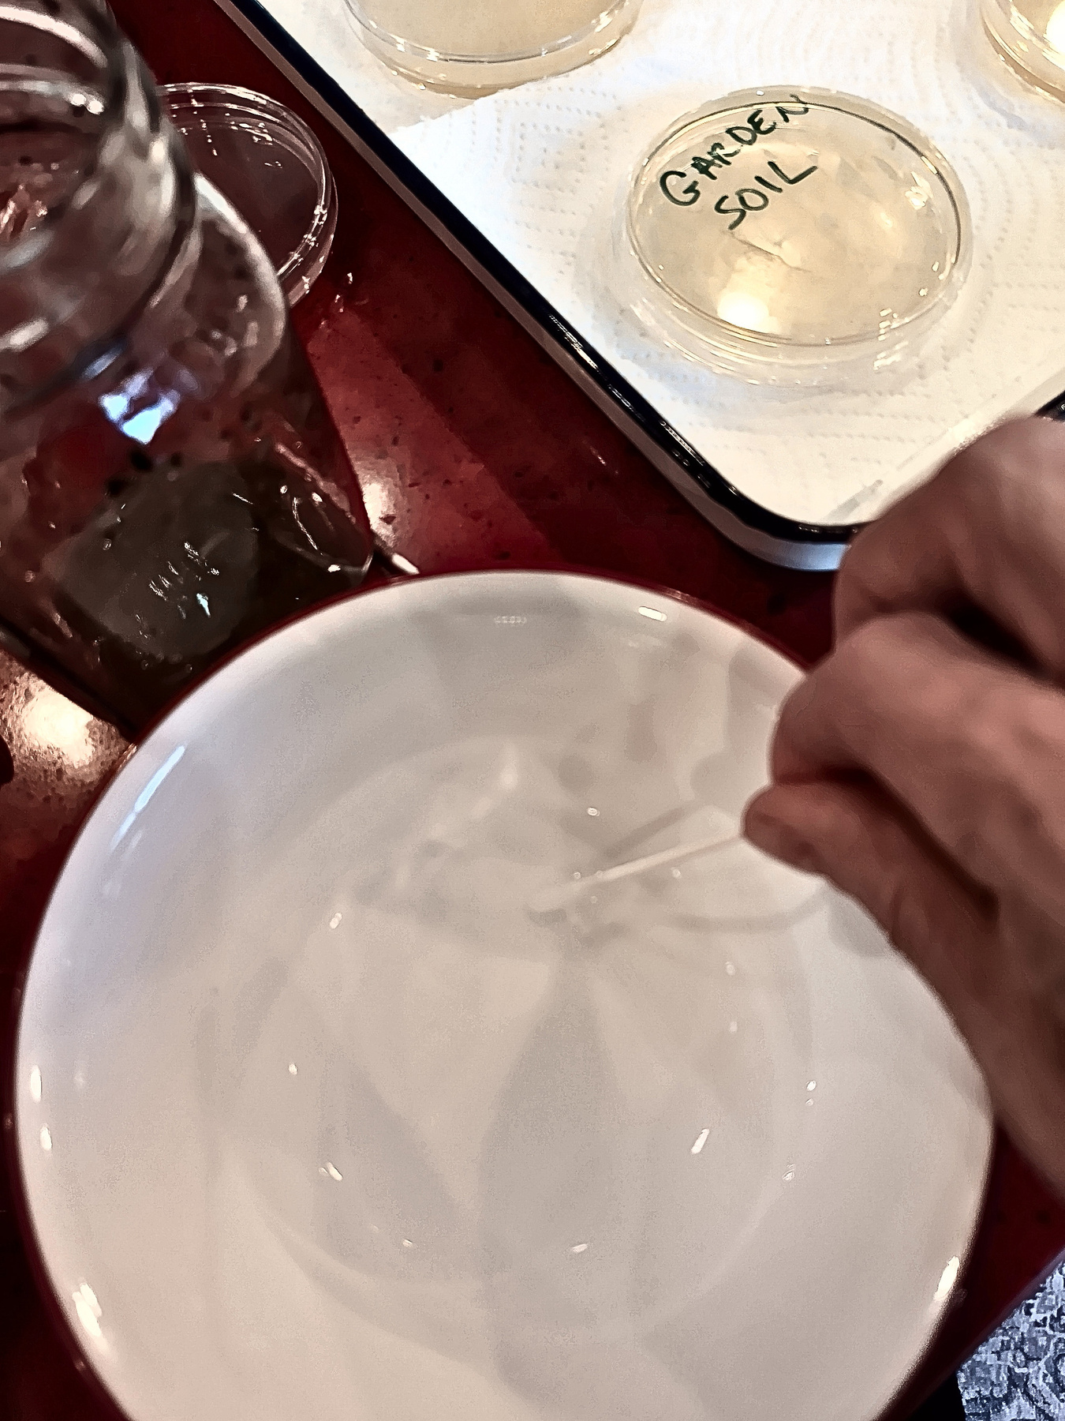
Collect your samples.
Dip a cotton swab in sterile or distilled water. (Do not soak the swab.)

Slide 3
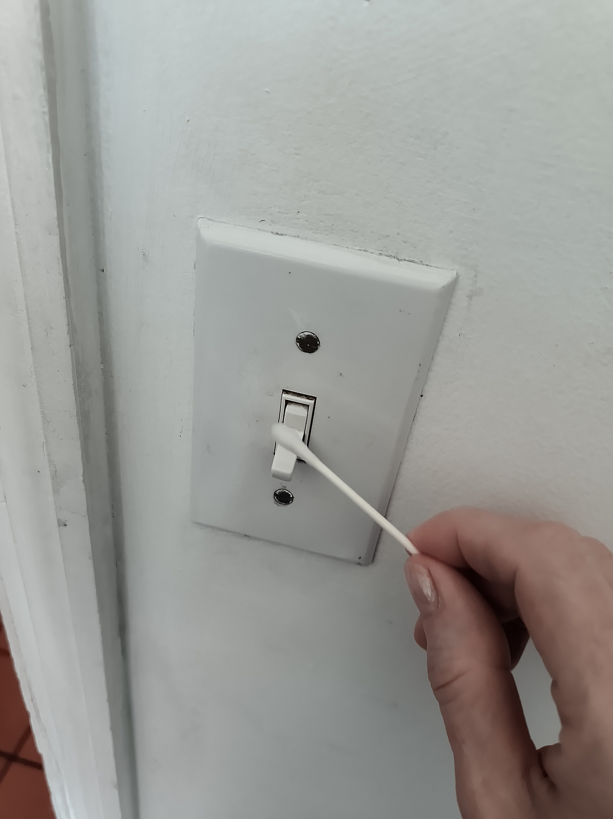
Gently rub the cotton swab on the surface you wish to test. Twirl the swab against the surface as you make the collection rather than just brushing it across the surface. This will help make sure you get a large sample of microbes.

Slide 4
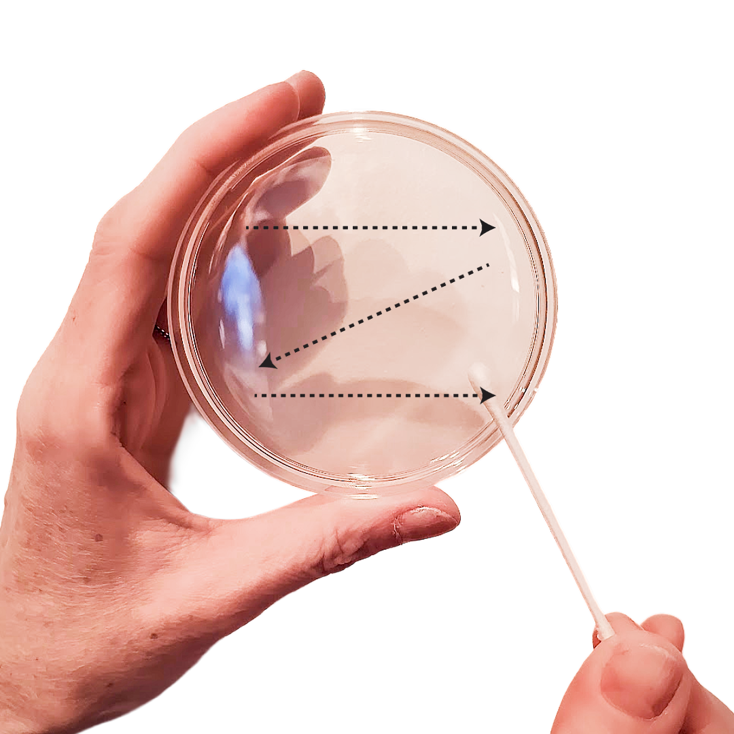
Lightly run your swab in a zigzag pattern across the agar. Think of it like drawing a “Z” and then turning the plate 90 degrees and drawing a “Z” with your swab again.

Slide 5
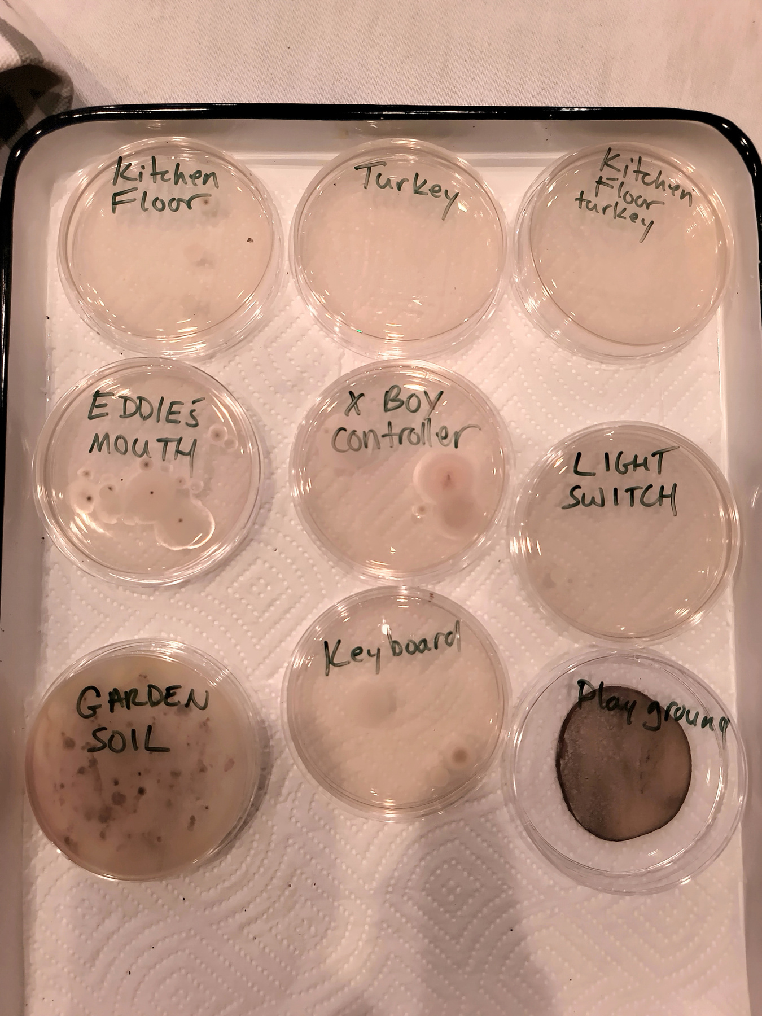
Close the plate and use just enough masking tape to hold the top and bottom together. Place the plate face down in a room-temperature (68–70°F) area for 2 to 3 days.
⚠️ Safety Notes: Do not open the plates after the colonies appear! After observations are complete, keep the plates sealed and place them in a sealed bag. An adult can disinfect them with a diluted bleach solution before throwing them away.
Always wash your hands after handling
the agar plates.

